Slide 1
Exadata
Embracing Change
What is familiar and what is new?
“The statements and opinions expressed here are my own and
do not necessarily represent those of Oracle Corporation.”

Slide 2
Exadata
Based on book review
Achieving Extreme Performance with Oracle Exadata
Rick Greenwald, Robert Stackowiak, Maqsood Alam, Mans Bhuller
Oracle Press
ISBN: 978-0-07-175259-6

Slide 3
Presentation Available
This presentation
And book review it is based on
Available at
www.brianhitchcock.net

Slide 4
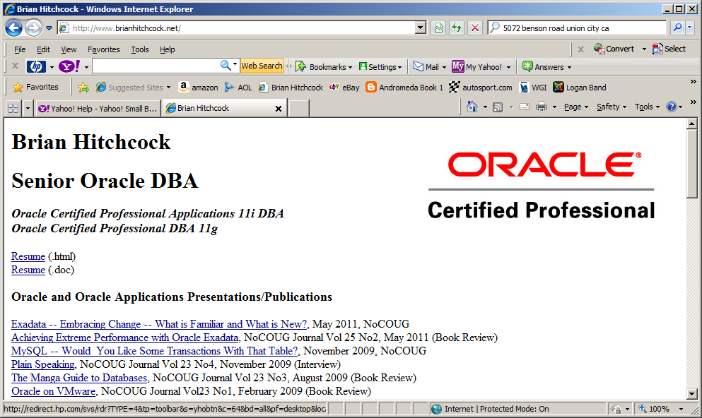
http://www.brianhitchcock.net/

Slide 5
Exadata
What is Exadata?
The Oracle Exadata Database Machine
Hardware
Software
Not just the Oracle database software
Exadata Storage Server software
If you take away only one thing...
Exadata is new hardware and new software
Software separate from database software

Slide 6
Exadata Full Rack
Exadata Storage Server software, disks and
Flash memory live here –OS is Linux
Storage Server Cells (7)
Database Server Nodes (4)
Database Server Nodes (4)
Most of what is new is in the Storage Server Software
Storage Server Cells (7)
11gR2 database software lives here – OS is Linux or Solaris

Slide 7
Exadata Storage Server
Exadata Storage Server Cell
CPUs – 2x6 core
Disks – 12x600Gb (High Performance)
Or 12x2Tb (High capacity)
Linux OS
Flash Cards – 4x96GB
Storage Server Software
Not just disks...

Slide 8
Exadata – Smart Scan
Smart Scan
Name for multiple performance features
Supports processing in the storage layer
All Smart Scan features done in Storage Server
Reduces amount of data returned to db instance
External to Oracle database software
Transparent to application and database
Reduces the resources needed for a query
Dramatic effect on performance

Slide 9
Full Table Scan
Standard query
Parsed
Execution plan
Request data from storage
Exadata query
Db node sends meta data to storage server
Describes query predicate
Storage server uses predicate info
Eliminates rows not needed
Returns fewer rows to database

Slide 10
Column Projection
Storage Server Software
Also eliminates columns not needed for query
Returns less data to database
Restrictions
No LOB columns
Not all comparison operators
Check using sql
SELECT * FROM v$sqlfn_metadata WHERE offloadable='YES';

Slide 11
Join Filtering
For joins
Smart Scan uses Bloom Filter
Eliminates rows in larger table
Based on row values in smaller table
Bloom Filter will
Never eliminate a needed row
Will allow some un-needed rows to pass
Exadata moves this filtering to storage server
Normally done in the db instance

Slide 12
Storage Indexes
Similar to partitioning
Eliminate data not needed for query
In memory data structure
Tracks high and low values for columns
For rows in a 1Mb storage region
Used by Storage Server
Eliminate storage regions not needed for query
Built when Smart Scan query hits Storage Server

Slide 13
Storage Indexes
Not enabled for LOB or NLS columns
Work best for queries
Selected column values are bunched in storage
Sort data before loading
Work with partitioning
Partition pruning for partitioned columns
Storage indexes for other columns

Slide 14
Smart Scan
Not all queries can benefit
Those that don't?
Processed normally
Storage Server just returns blocks
Just like non-Exadata database
Best performance
Most queries can use Smart Scan

Slide 15
Explain Plan
Smart Scan
New entries in Explain Plan
Show where 'offloading' done
Processing offloaded to Storage Server
Operation column
TABLE ACCESS STORAGE FULL
'STORAGE' identifies steps that were offloaded
Not all STORAGE steps will be offloaded
Storage server decides at runtime

Slide 16
Compression
Compression reduces
storage required
Size of data moved to/from database
Memory required
Increases I/O bandwidth
Oracle database
Has some compression features
Exadata has EHCC
Exadata Hybrid Columnar Compression

Slide 17
EHCC
Different from database compression
Data stored by columns
But only for a set of rows
Compression Unit
Hold data for all columns for set of rows
Retrieved with single I/O operation
Updates are problematic
EHCC best for data that is static

Slide 18
EHCC options
Query compression
Reduces storage by 10x
Decompression CPU impact minimal
Archive compression
Reduces storage by 15x to 70x
Queries slower
Practical to store large historical datasets online

Slide 19
EHCC
Decompression
Needed to return rows for result sets
Can be done in Storage Server or database node
Compression only done in db node
Only columns needed for query
EHCC best for queries that are I/O bound
Need CPU capacity for decompression
Combine with partitioning
EHCC for partitions that are read-only

Slide 20
Smart Flash Cache
Flash storage (memory)
Part of Storage Server cell
Not the same as Database Flash Cache!
Flash memory as extension of db cache
Can be configured as a disk
Not recommended
For redo logs, disk as fast as flash (!!!)
Storage Server Software
Makes intelligent use of flash storage

Slide 21
Smart Flash Cache
What does Smart Flash Cache cache?
Data that is likely to be accessed again
Data not part of a large scan
Doesn't cache
Writes for backups
Mirroring operations
Data pump operations
Only for data objects with
CELL_FLASH_CACHE set to DEFAULT

Slide 22
Smart Flash Cache
CELL_FLASH_CACHE
NONE
Data object not stored
KEEP
Data object kept for longer time
Aging algorithm less aggressive
80% max allowed for KEEP objects
Can KEEP tables
ALTER TABLE CUSTOMER storage (CELL_FLASH_CACHE_KEEP)

Slide 23
Smart Flash Cache
Storage Server Software
Reads from Flash Cache and disk
Best aggregate scan rate
Smart Flash Cache Statistics
Storage Server utility CellCLI
CellCLI> LIST METRICCURRENT WHERE objectType='FLASHCACHE'
More than 30 statistics available
CellCLI is not SQL*Plus!

Slide 24
Smart Flash Cache
Ratio Flash Cache to total disk storage
Studies show working set is about 18% of dataset
Working set is data actually accessed in real time
Exadata Flash Cache capacity
Chosen to support working set in flash memory
Good trivia!

Slide 25
Storage Server Management
CellCLI
Command interface to Storage Server
Operates on objects that have attributes
Different from SQL*Plus!
Controls one Storage Server Cell
Dcli
Can issue commands to multiple cells
Runs CellCLI and OS commands
ADRCI
Stores info for any problems in the cell

Slide 26
LUNS, grid disks etc?
Each disk is a LUN
Storage Server software creates a cell disk
Cell disks become grid disks
Presented to ASM
Can have multiple grid disks per cell disk
Outer tracks assigned first – fastest performance
Inner tracks for data accessed less often
Too many choices?

Slide 27
Encryption
Smart Scan Operations
Performed directly on encrypted data
Decryption can be done at Storage Server
Coupled with compression
Reduce size of data to be encrypted
Dedicated Hardware
Westmere chip
Storage Server and Database Node

Slide 28
Backup
RMAN is only supported option
No 3rd-party hardware allowed
No snapshots
Need to integrate this with existing process
Non-Rman backups
Backup, restore, clone to non-Rman databases

Slide 29
Exadata – Capacity?
Quarter Rack
2 db nodes, 3 storage servers
1.1Tb Flash Cache, 9Tb/31Tb* disk storage
Half Rack
4 db nodes, 7 storage servers
2.6Tb Flash Cache, 22Tb/75Tb* disk storage
Full Rack
8 db nodes, 14 storage servers
5.3Tb Flash Cache, 45Tb/150Tb* disk storage
*High Performance vs High Capacity disks

Slide 30
High Availability
DataGuard
If using EHCC
If standby isn't Exadata
Data on standby will be compressed
At failover, must uncompress
Compression can be up to 70x
Standby needs 70x disk space of primary
Recommended Solution
Exadata for both primary and standby

Slide 31
Exadata – Support Roles?
Who configures Storage Server?
SA, DBA, other?
Who handles patching, RMAN, ASM?
Who will monitor Smart Flash Cache stats?
More things to configure and monitor
How to integrate with your existing processes?
Patching
Security
SOX and other audits

Slide 32
Exadata – Transparency?
Existing applications run on Exadata
No changes required
This is what we want...
Required to be able to migrate
11gR2, RMAN, ASM, no snapshots
No LOB columns
Optional, but needed to get best performance
RAC, partitioned tables
Most queries use Smart Scan

Slide 33
Exadata – Transparency?
Example:
Most of my databases are not 11gR2
I don't use ASM or RMAN
I make backups using snapshots
I don't know if I have LOB columns
Are my tables partitioned?
I'm not using RAC
Exadata may well be transparent...
But the effort required to be ready to move...?

Slide 34
Exadata – Transparency?
Dev, Test, Production
All in one Exadata?
Patching
Some patches affect entire machine
Optimal use of parallel processing
Three isolated environments can't share resources
Three Exadata machines?
Plus DR machine for DataGuard

Slide 35
Conclusion
Exadata brings many new features
Each feature has lots more details
Not all covered here
Review the book or the Exadata doc set
Transparency
Will you get all the benefits?
After upgrades to be able to move to Exadata
After integrating with your existing processes

