Slide 1


Slide 2

Aim High with Oracle Real World Performance
Andrew Holdsworth
Director Real World Performance Group Server Technologies

Slide 3


Real World Performance Agenda
<Insert Picture Here>
Thinking Strategically about Performance
The Fork Lift Upgrade
Data Warehouse Systems
Operational Systems
Getting Serious about Performance

Slide 4
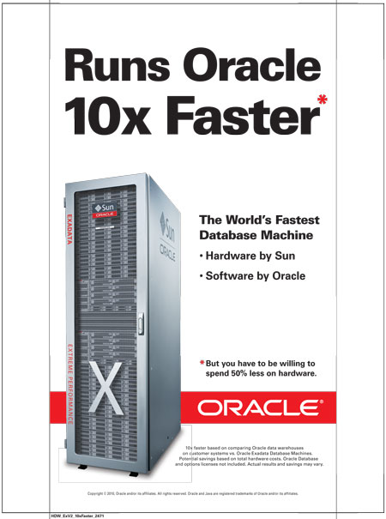
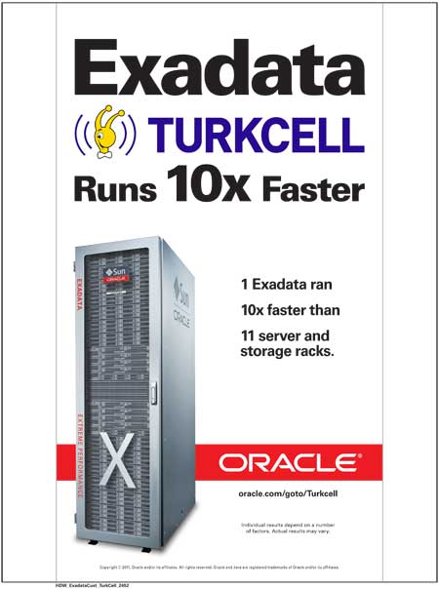
Airport/Economist 10X

Slide 5
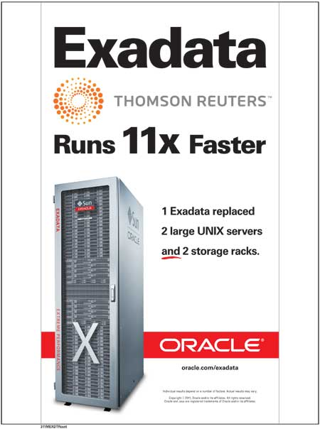
Airport/Economist 11X

Slide 6
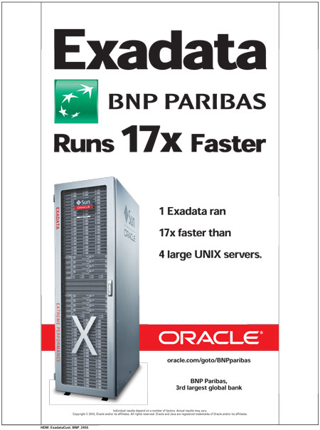
Airport/Economist 17X

Slide 7
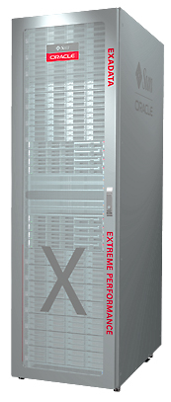
State of the Art Intelligent HW and SW
EXADATA
HW
  Intel Westmere and Nehalem Xeon CPUs
  Infiniband
  10G Network Cards
  Disks
SW
  Hybrid Columnar Compression
  Offloaded Queries ( Column reduction and predicates )
  SW Smarts for disk I/O and User Space I/O

Slide 8
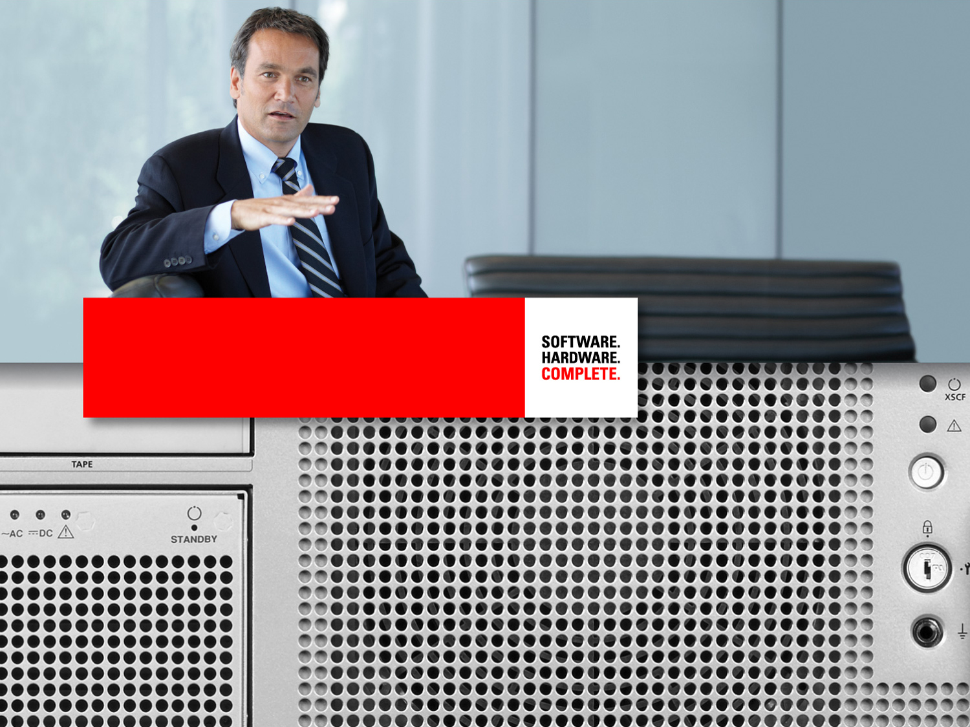
Changing The Culture

Slide 9
Thinking Strategically About Performance
To much hope and see approach to performance
  Systems put together without much thought as to how to achieve performance targets
  Culture of looking for the magic silver bullet
  Lack numerate discussions, decisions made by strength of personality
  Lack of understanding of what can be achieved
  Unaware of today’s/current systems limitations

Slide 10
Changing the Culture
Learning to set expectations higher then Moore’s Law
  Learn how to move the decimal point
  Learn to choose the appropriate weapons
  What things never change

Slide 11
Changing the Culture
Hacking Culture
  Performance is seen as glamorous until it gets hard
  Tuning by Google
  Running a different database product different to the one developed and supported

Slide 12
Thinking Strategically About Performance
Need to change the Culture of “Good Enough”
  “Good Enough” is NOT and will NOT be “Good Enough” tomorrow
  Good Performance Engineers are relentless and don’t leave performance on the table
  Always looking to move the decimal point
  In summary “Aim High”

Slide 13
The Forklift Upgrade

Slide 14
The Fork Lift Upgrade
The Forklift Upgrade
Concept: Just migrate your existing applications without change onto a new faster platform
  It should run faster
  It should be able to exploit new technologies
  It should eliminate my scaling and cost challenges
  The code I run has been running in production and so must perfect or “Good Enough”
  I have spent a fortune developing this application with cheap developers, who have since left anyway and nobody knows to maintain it!

Slide 15
The Fork Lift Upgrade
Just because a system runs satisfactorily today do not assume it will scale
Faster equipment will move bottlenecks to new places
Poor coding techniques WILL get exposed faster
How much is your Old Code holding you back
How much performance is left on the Table
How many existing Oracle version changes
How many Architecture issues will I have to absorb

Slide 16
The Fork Lift Upgrade
Now I have scared you, what should we be looking to exploit and where ?
  DW – Target rich environment with the biggest potential for dramatic performance improvement
  OLTP – Steady gains but huge chance to make the systems more reliable and predicable

Slide 17
Data Warehouse Systems

Slide 18
Data Warehouse Systems
The Wrong HW pathology
  To few CPUs to drive multi million row queries 10X
  I/O not balanced with CPUs 10X
  Incorrect Networking strategies 10X
Queries
  Incorrect Query strategy 10X
ETL and Loading Degraded
  Slowdowns and serialization
  Database size bloat
Desire to make the systems look productive
  Overloaded query streams 10X

Slide 19
Data Warehouse Systems
Learn the basic skills of Large numbers of rows vs small numbers of rows
  Scans vs Index access
    Index Driven Query retrieving 1,000,000 rows
      Assume the Index is cache and the data is not.
      1,000,000 random IOPS @ 5ms per I/O
      This required 5000 Seconds to Execute
      This is why queries may take over an hour
    How much data could you scan in 5000 Seconds with a fully sized I/O system able to scan 28 Gig/Sec ?
  Hash techniques vs row by row ( Join and Sort )

Slide 20
Data Warehouse Systems
Having eliminated the Hardware Bottlenecks
  Resource Management
    Keeping the system safe
    Allocating resources by priority
    Learn about query queuing
      Historically the Queue was the I/O subsystem
ETL and Data Loading
  Row by Row processing
  Direct Path vs Transactional SQL
  Compression techniques
Are you the problem ?
  All that experience is it holding you back ?

Slide 21
Operational Systems

Slide 22
OLTP and Operational Systems
Eliminating the Seeks
  Flash devices and large buffer caches
Exploiting the CPUs
  L2 caches
    Moore’s law upgrades
    Fewer processes
    Less stalling on memory access
Resource Management
  Preventing run away systems

Slide 23
Getting Serious about Performance

Slide 24

Getting Serious about Performance
Parallel Set based processing
DML re-written as CTAS or IAS
I/O Balanced, Minimized, Optimized by Capacity Planning, Compression, Caching and Offload
Exploitation of parallel query techniques
1000x
CPU Upgrade from latest generation Intel Processors
500x
100x
50x
5x
10x

Slide 25
Getting Serious about Performance
Performance Techniques as Disruptive Technologies
  10x Minutes to Seconds
  100x Hours to Minutes
  1000x Hours to Seconds
Will these speed ups mean ?
  Speed to market
  Less deferred batch
  Increased operational agility
  Early detection of mistakes
Now Make your systems GO FAST !

