Slide 1

DB Performance with
Graphics
Kyle Hailey
Performance Architect at Delphix
http://dboptimizer.com http://oraclemonitor.com

Slide 2

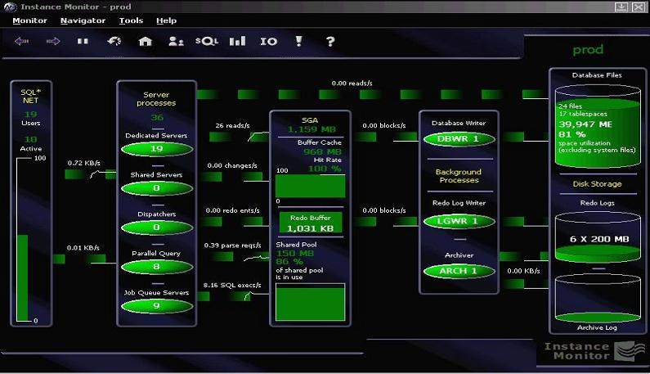
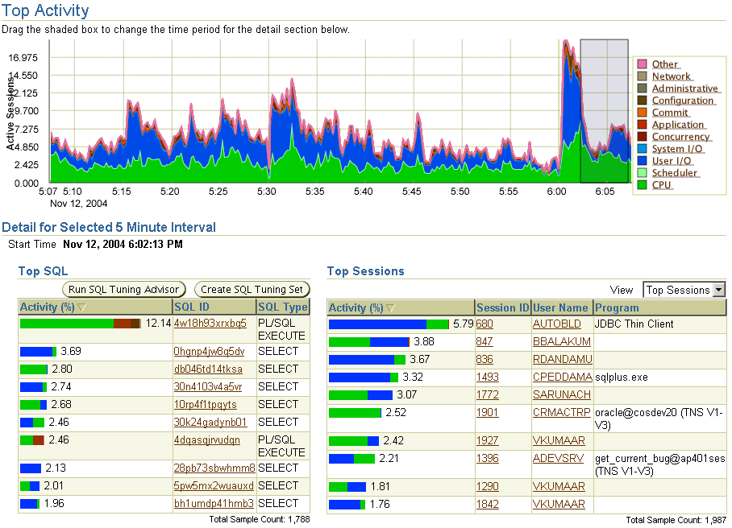





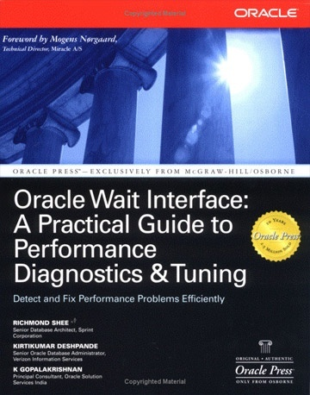


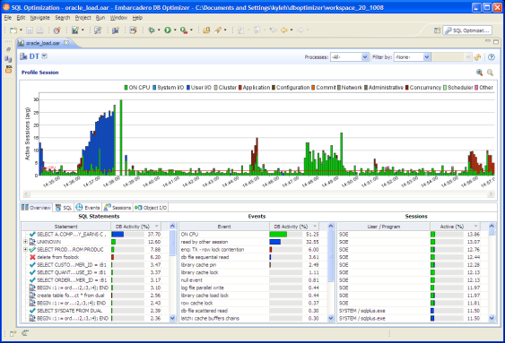
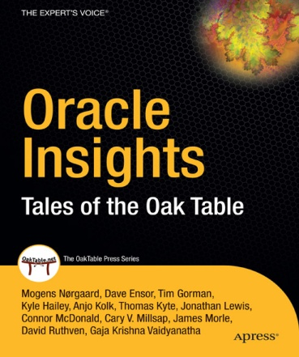
Who is Kyle Hailey
1990 Oracle
  90 support
  92 Ported v6
  93 France
  95 Benchmarking
  98 ST Real World Performance
2000 Dot.Com
2001 Quest
2002 Oracle OEM 10g
2005 Embarcadero
  DB Optimizer
Delphix
Success!
First successful OEM design
Notes:
In Oracle Support I learned more faster than I think I could have anywhere.
Porting gave me my first appreciation for the shareable nature of Oracle code and also a bit of disbelief that it worked as well as it did.
Oracle France gave me an opportunity to concentrate on the Oracle kernel.
At Oracle France I had 3 amazing experiences. First was being sent to the Europecar site where I first met a couple of the people who would later become the founding members of the Oaktable, James Morle and Anjo Kolk. The Europecar site introduced me to a fellow name Roger Sanders who first showed me the wait interface before anyone knew what it was. Roger not only used it but read it directly from shared memory without using SQL.
Soon after Europecar I began to be sent often to benchmarks at Digital Europe. These benchmarks were some of my favorite work at Oracle. The benchmarks usually consisted of installing some unknown Oracle customer application and then having a few days to make it run as fast as possible. I first started using TCL/TK and direct shared memory access (DMA) at Digital Europe and got solid hands on tuning experience testing things like striping redo and proving it was faster long before people gave up arguing that this was bad from a theoretical point of view.
Finally in France, my boss, Jean Yves Caleca was by far the best boss I ever had, but on top of that he was wonderful at exploring the depths of Oracle and explaining it to others, teaching me much about the internals of block structure, UNDO, REDO and Freelsits.
I came back from France wanting to do performance work and especially graphical monitoring. The kernel performance group had limited scope in that domain, so I left for a dot com where I had my first run as the sole DBA for everything, backup, recovery, performance, installation and administration. I was called away by Quest who had my favorite performance tool Spotlight. It turns out thought that scope for expanding Spotlight was limited so I jumped at the chance in 2002 to restructure Oracle OEM. The work at OEM I’m proud of but still want to do much more to make performance tuning faster, easier and more graphical.

Slide 3




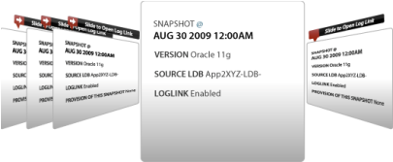



Fast, Non-disruptive Deployment
Production
Development
Q/A
Reporting
UAT
Sync via standard APIs
1 TB VDB
1 TB VDB
1 TB VDB
1 TB VDB
1 TB
1 TB
1 TB
1 TB
1 TB
Provision and refresh from any time or SCN
NFS
Software appliance installs in under an hour on bare-metal x86 servers using SAN storage or in a VM for Oracle 10g or 11g on Linux, Solaris, AIX, and HP-UX
300MB
>> Strictly Confidential
Notes:
Let’s take a look at how Delphix works
Our software installs on bare-metal x86 servers or in a VM in as little as half an hour
And you can get the entire system up and running with virtual databases in as little as an hour or two with a small database [or schedule the loading overnight for a large database]
Today Delphix supports Oracle 10 and 11g on Linux, Solaris, AIX, and HP-UX
[If asked about other DBs, say Delphix will support MS SQL later this year]
[If asked about OS, Delphix is a wholly contained operating environment; customers manage only the Delphix application]
[Others storage types, like DAS or NAS may be supported when running in a VM]

Slide 4






Combine Prod Support and DR
R/3 ERP
BW
CRM
GTS
T&E
Sales CRM
Production SAP Landscape
PRIMARY DATACENTER
R/3 ERP
BW
CRM
GTS
T&E
Sales CRM
Standby via DataGuard
Dev: Prod Support
QA: Prod Support
Dev: Project
QA: Project
>> Strictly Confidential
Notes:
Let’s take a closer look at the architecture
They use SAP, which requires multiple databases to be federated or in sync at the same point in time
They used to create entire copies of these federated “landscapes” manually, which took several days each time
They also had a DR site where they performed DR testing on a metro campus
[Click]
With our software, they replaced all those redundant copies with a Delphix Server
With LogSync, we can easily provision multiple databases at the same point in time to “federate” the VDBs
So now they can provide virtual landscapes on demand
They also use Delphix to perform DR testing
[Performance isn’t a problem because they have low latency and high bandwidth in their metro campus, which allows them to do all of this from one site]

Slide 5
Overview
Graphics
Database Tuning
SQL Tuning

Slide 6
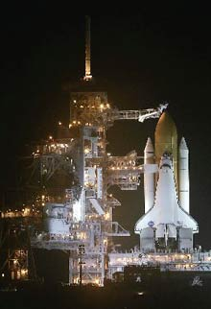
Launch: Pressure
Midnight before
January 28, 1986
Lives are on the line
Thanks to Edward Tufte

Slide 7
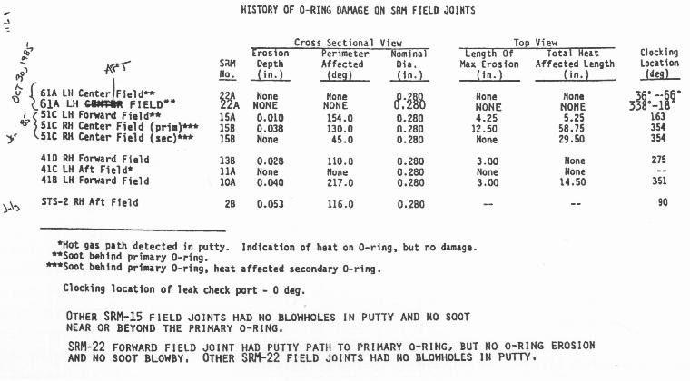
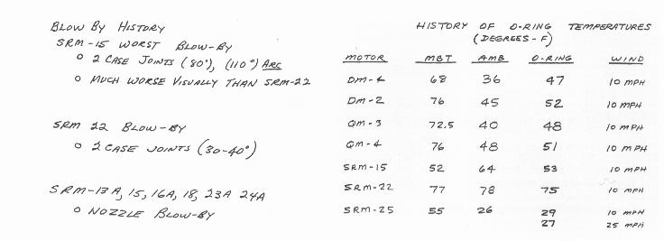
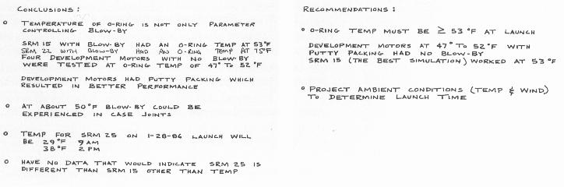
13 Pages Faxed

Slide 8
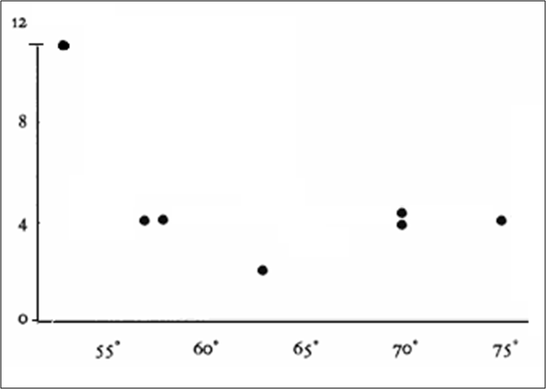
Original Engineering data
“damages at the hottest and coldest temperature”
- management
only showed damage

Slide 9
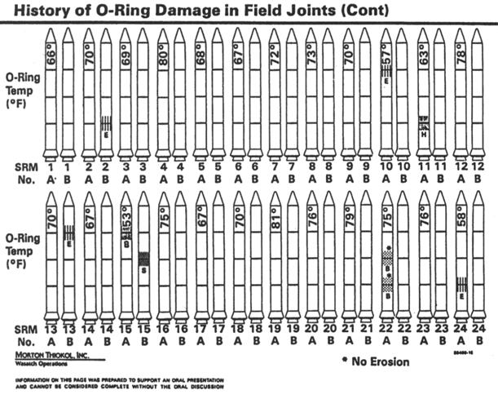
Congressional Hearings Evidence

Slide 10
Clearer
12
12
8
8
X
4
4
30
35
40
45
50
55
60
65
70
75
80
Include successes
Mark Differences
Normalize same temp
Scale known vs unknown

Slide 11
Difficult
NASA Engineers Fail
Congressional Investigators Fail
Data Visualization is Difficult
But …
Lack of Clarity can be devastating

Slide 12
Solutions
Clear Identification
  Know how to identify problems and issues
Access to details
  Provide solutions and/or information to address the issues
Graphics
  Easy understanding, effective communication and discussion

Slide 13
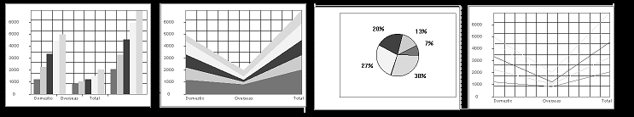

First Step: Graphics
“The humans … are exceptionally good at parsing visual information, especially when that information is coded by color and/or _____ .”
Knowledge representation in cognitive science. Westbury, C. & Wilensky, U. (1998)
motion

Slide 14
Why Use Graphics
You can't imagine how many times I was told that nobody wanted or would use graphics …
-- Jef Raskin, the creator of the Macintosh
Infocus – (overhead projectors) sited a study that humans can parse graphical information 400,000 times faster than textual data
Notes:
What allows Oracle, all the dials and knobs, to be the fastest, most robust database on the market also make it one of the most complicated on the market. For those few users that know and love the 1000s of performance options in Oracle, access to those performance options through sql and C code is the defacto standard. For seasoned users it is often difficult to understand why anyone would want to be limited by a GUI which can often be slower, and almost always lacking the latest commands allowed through interfaces such as SQL and C.
On the OEM side, when a new tuning feature in the kernel is externalized in OEM (Oracle Enterprise Manager) it is often difficult to see the forest for the tree, or where and how that new feature fits into the grand scheme of things.

Slide 15
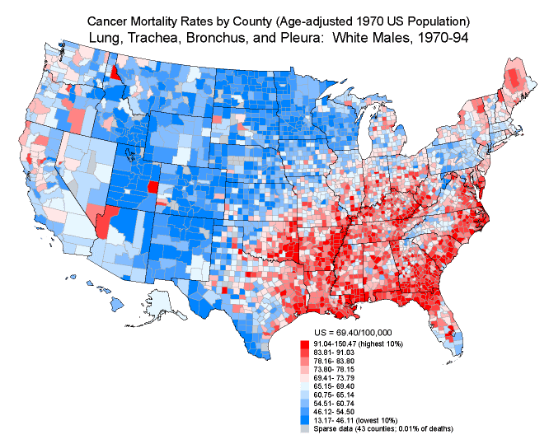
Counties in US
3101 Counties in US
50 pages

Slide 16
“If I can't picture it, I can't understand it”
- Albert Einstein
 | Anscombe's Quartet
 | I |  | II |  | III |  | IV
 | x | y | x | y | x | y | x | y
 | 10 | 8.04 | 10 | 9.14 | 10 | 7.46 | 8 | 6.58
 | 8 | 6.95 | 8 | 8.14 | 8 | 6.77 | 8 | 5.76
 | 13 | 7.58 | 13 | 8.74 | 13 | 12.74 | 8 | 7.71
 | 9 | 8.81 | 9 | 8.77 | 9 | 7.11 | 8 | 8.84
 | 11 | 8.33 | 11 | 9.26 | 11 | 7.81 | 8 | 8.47
 | 14 | 9.96 | 14 | 8.1 | 14 | 8.84 | 8 | 7.04
 | 6 | 7.24 | 6 | 6.13 | 6 | 6.08 | 8 | 5.25
 | 4 | 4.26 | 4 | 3.1 | 4 | 5.39 | 19 | 12.5
 | 12 | 10.84 | 12 | 9.13 | 12 | 8.15 | 8 | 5.56
 | 7 | 4.82 | 7 | 7.26 | 7 | 6.42 | 8 | 7.91
 | 5 | 5.68 | 5 | 4.74 | 5 | 5.73 | 8 | 6.89
Average | 9 | 7.5 | 9 | 7.5 | 9 | 7.5 | 9 | 7.5
Standard Deviation | 3.31 | 2.03 | 3.31 | 2.03 | 3.31 | 2.03 | 3.31 | 2.03
Linear Regression | 1.33 |  | 1.33 |  | 1.33 |  | 1.33

Slide 17
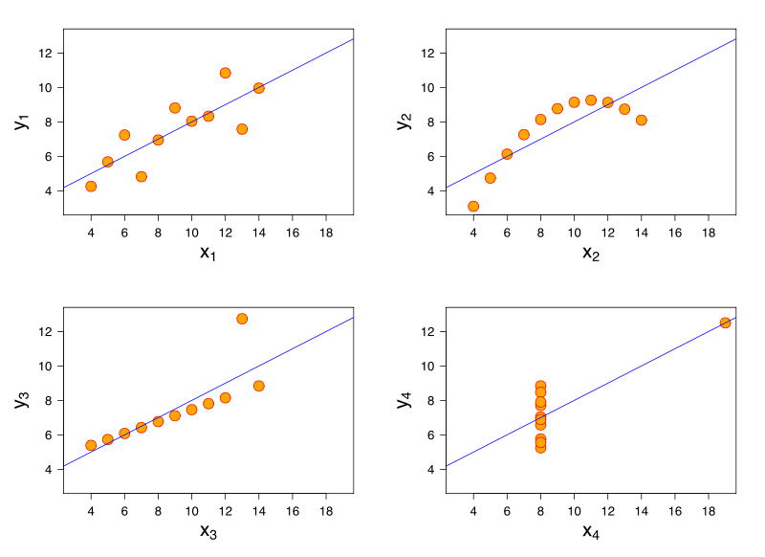
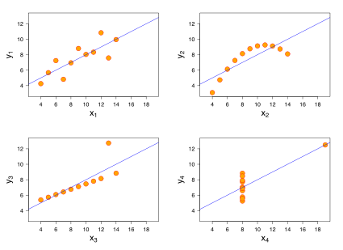
Graphics for Anscombe’s Quartet

Slide 18
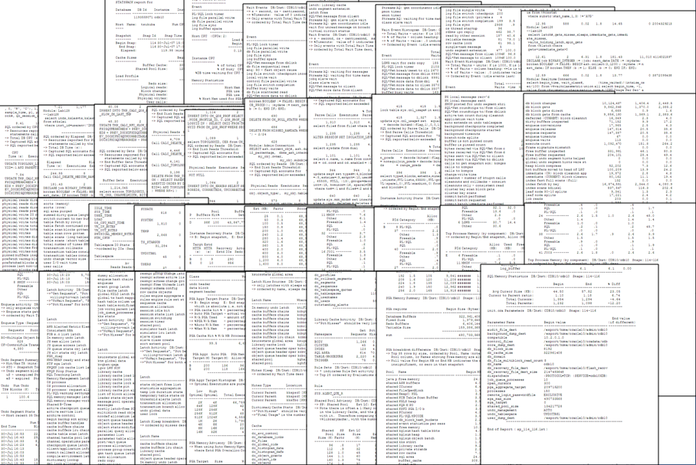
Tuning the Database
Complex
What is a day in the life look like for a DBA who has performance issues?
Averages
 | Anscombe's Quartet
 | I |  | II |  | III |  | IV
 | x | y | x | y | x | y | x | y
Average | 9 | 7.5 | 9 | 7.5 | 9 | 7.5 | 9 | 7.5
Standard Deviation | 3.31 | 2.03 | 3.31 | 2.03 | 3.31 | 2.03 | 3.31 | 2.03
Linear Regression | 1.33 |  | 1.33 |  | 1.33 |  | 1.33

Slide 19
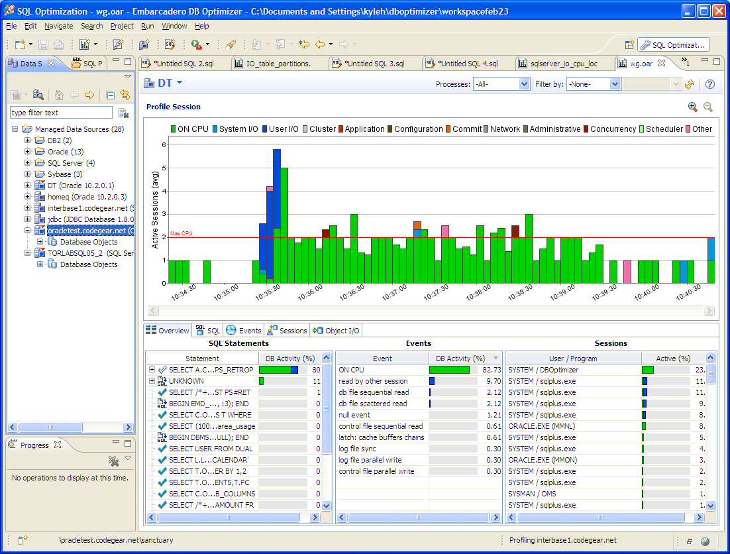
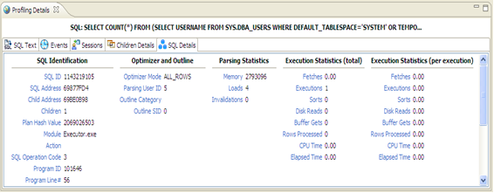
How Can We Open the Black Box?
LOAD
Max CPU
(yard stick)
Top Activity
Click here
SQL
Events
Sessions
Get Details

Slide 20
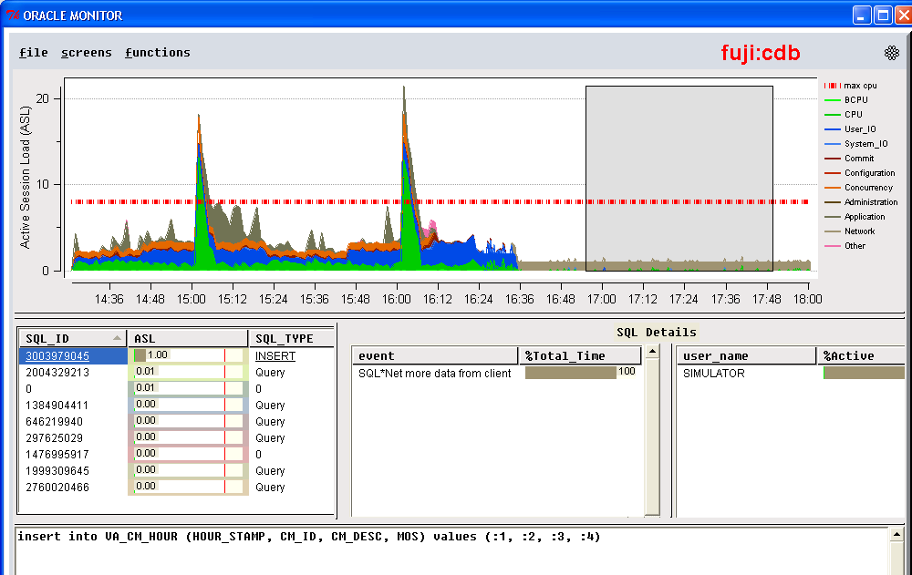
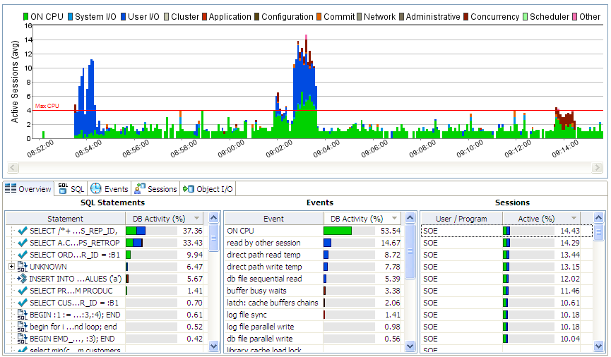
How Can We Open the Black Box?
OEM
ASHMON/SASH
DB Optimizer
Powerful - Identifies issues quickly and powerfully
Interactive - Allows exploring the data
Easy - Understandable by everyone, DBA, Dev and Managers !

Slide 21
How do we get our data?
Database
User 1
User 2
User 3
User 4
=
4
3
Active Sessions
2
1
Graph represents # of sessions active, but also represents amount of time active in the database
For Every Active Session there is a user (or application) waiting
Sample v$session : fast and light weight
We collect
  session
  SQL
  State (CPU, IO, LOCK, Other Waits)

Slide 22
AWR collects
SQL (v$sqlstats)
Waits (v$system_event)
F1qcyh20550cf
fj6gjgsshtxyx
0cjsxw5ndqdbc
8t8as9usk11qw
dr1rkrznhh95b
10dkqv3kr8xa5
38zhkf4jdyff4
298wmz1kxjs1m
CPU
Enq: TX – row lock contention
SQL*Net break/reset to client
db file scattered read
db file sequential read
Sessions (v$sesstat)
Which session executed which SQL?
Which SQL was block on a wait event ?
25
34
36
38
45
63
65
87
AWR ( and Statspack)
Can’t answer!
Old Method

Slide 23
After sampling Multi-dimensional
SQL
Package
Procedure
Plan
Child #
Module
Action
F1qcyh20550cf
fj6gjgsshtxyx
0cjsxw5ndqdbc
8t8as9usk11qw
dr1rkrznhh95b
10dkqv3kr8xa5
38zhkf4jdyff4
298wmz1kxjs1m
Sampling
V$SESSION
File, block, object
p1, p2, p3
Waits
Statistics
Sessions
25 34 36 38 45 63 65 87
CPU
Enq: TX – row lock contention
SQL*Net break/reset to client
db file scattered read
db file sequential read
Program
Sqlplus
SQL*Forms
User
Sys
Scott
System
Service
GL
OE
Application
IO

Slide 24
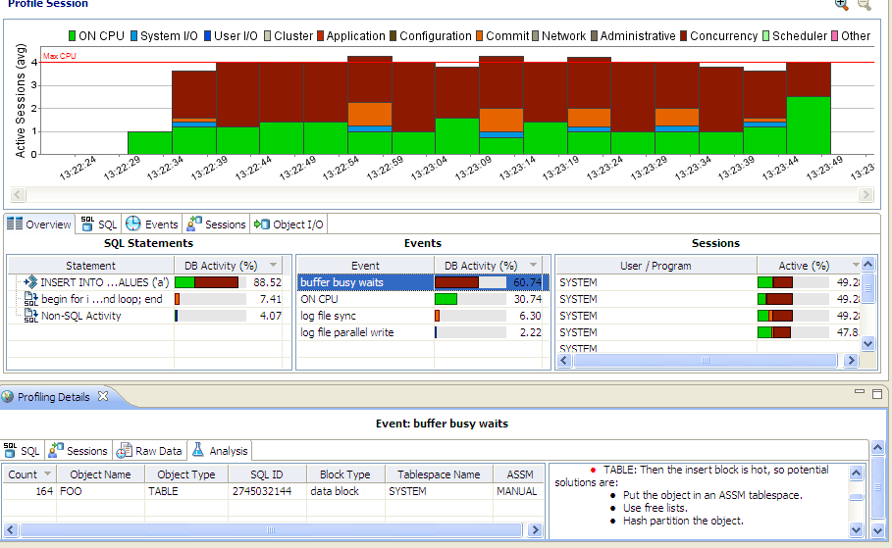
DB Optimizer shows it all

Slide 25
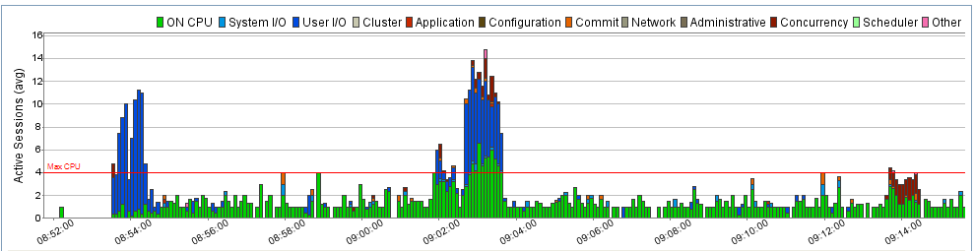
Average Active Sessions (AAS)
Use CPU count as yardstick:
AAS < 1
  Database is not blocked
AAS ~= 0
  Database basically idle
  Problems are in the APP not DB
AAS >> # of CPUS
  There is a bottleneck
2/24/2011
25
Notes:
25
25

Slide 26
Interpreting the Load Chart
Application
  Code inefficient?
Database
  Configured correctly?
Machine
  Is the machine undersized?
SQL
  Inefficient SQL?
Who’s problem is it ?
Chart answers this question and assists with solutions

Slide 27
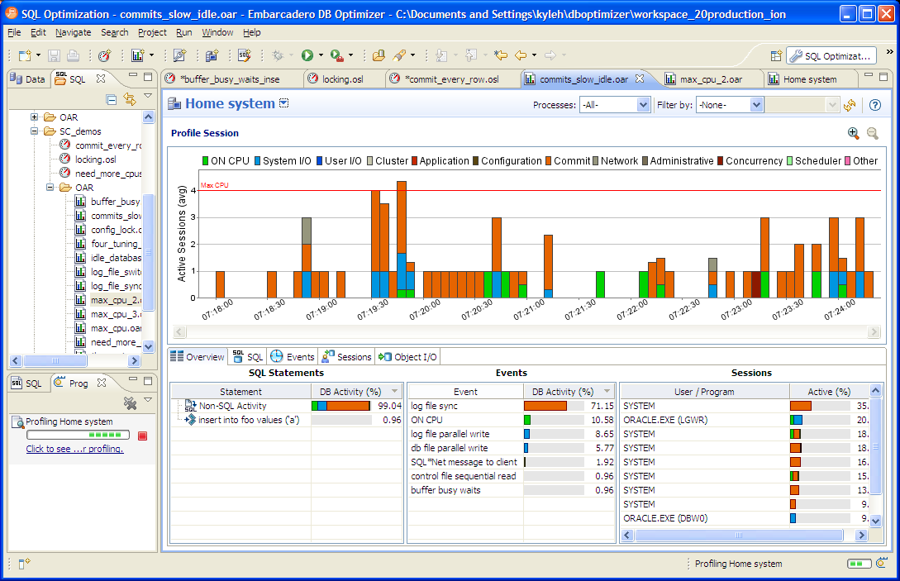
1. Application Issues
4 concurrent sessions run :
insert into foo values ('a');
commit;
insert into foo values ('a');
commit;
insert into foo values ('a');
commit;
insert into foo values ('a');
commit;
insert into foo values ('a');
commit;
insert into foo values ('a');
commit;
insert into foo values ('a');
commit;

Slide 28
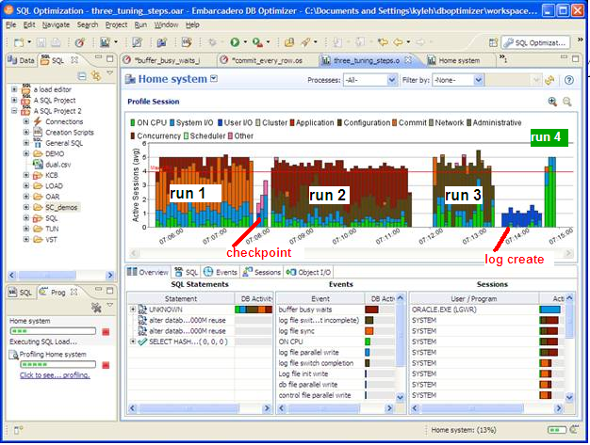
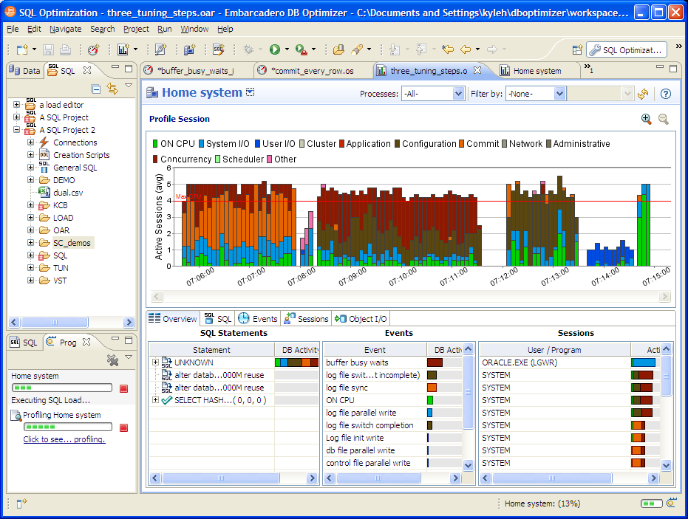
2. Database issue
4 concurrent sessions run :
begin
for i in 1..1000 loop
insert into foo values ('a');
end loop;
end;
/
Commit;

Slide 29
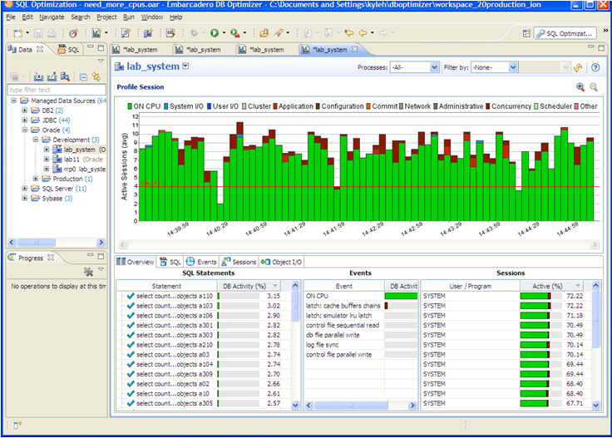
3. Machine Undersized

Slide 30
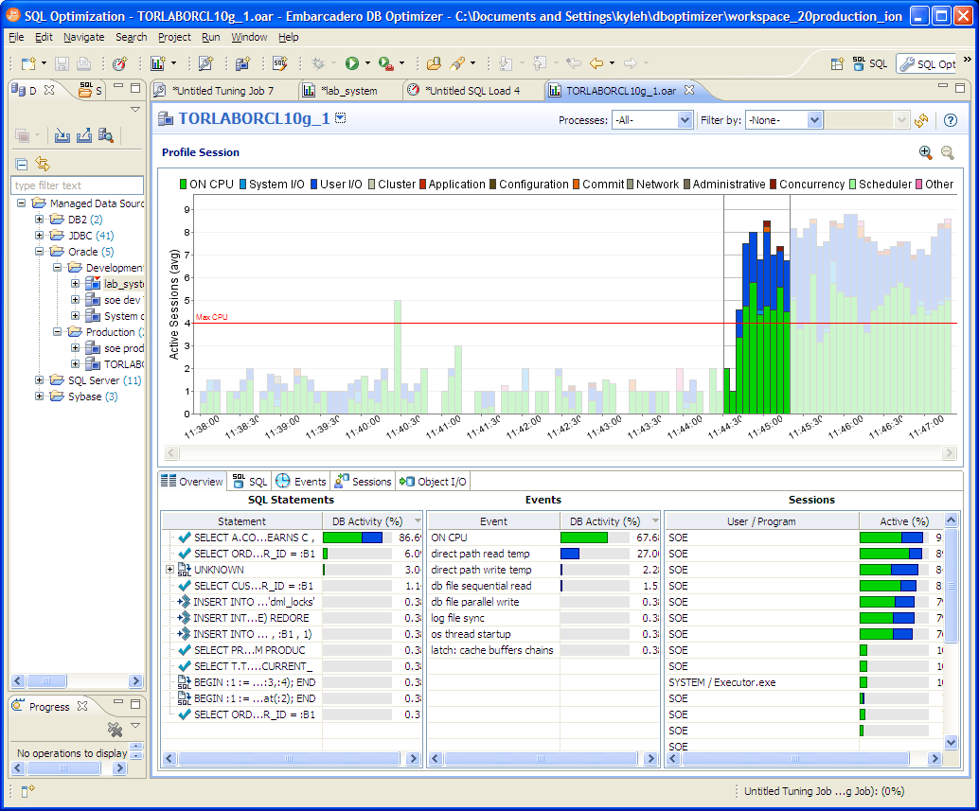
4. SQL needs Tuning

Slide 31
Tuning SQL Complexity
Trace file
Execution Plan
PARSING IN CURSOR #2 len=53 dep=0 uid=61 oct=3 lid=61 tim=1151519905950403 hv=2296704914 ad='4e50010c'
SELECT 'Hello, world; today is ' || SYSDATE FROM dual
END OF STMT
PARSE #2:c=4000,e=1540,p=0,cr=0,cu=0,mis=1,r=0,dep=0,og=1,tim=1151519905950397
BINDS #2:
EXEC #2:c=0,e=58,p=0,cr=0,cu=0,mis=0,r=0,dep=0,og=1,tim=1151519906034782
WAIT #2: nam='SQL*Net message to client' ela= 2 driver id=1650815232 #bytes=1 p3=0 obj#=-1 tim=1151519906034809
FETCH #2:c=0,e=29,p=0,cr=0,cu=0,mis=0,r=1,dep=0,og=1,tim=1151519906034864
WAIT #2: nam='SQL*Net message from client' ela= 215 driver id=1650815232 #bytes=1 p3=0 obj#=-1 tim=1151519906035133
FETCH #2:c=0,e=1,p=0,cr=0,cu=0,mis=0,r=0,dep=0,og=0,tim=1151519906035165
WAIT #2: nam='SQL*Net message to client' ela= 1 driver id=1650815232 #bytes=1 p3=0 obj#=-1 tim=1151519906035188
WAIT #2: nam='SQL*Net message from client' ela= 192 driver id=1650815232 #bytes=1 p3=0 obj#=-1 tim=1151519906035400
STAT #2 id=1 cnt=1 pid=0 pos=1 obj=0 op='FAST DUAL (cr=0 pr=0 pw=0 time=3 us)
--------------------------------------------------------------------------------------------
| Id | Operation | Name | Starts | E-Rows | A-Rows |
---------------------------------------------------------------------------------------------
| 1 | HASH GROUP BY | | 1 | 1 | 1 |
|* 2 | FILTER | | 1 | | 1909 |
|* 3 | TABLE ACCESS BY INDEX ROWID | PS_RETROPAYPGM_TBL | 1 | 1 | 3413 |
| 4 | NESTED LOOPS | | 1 | 165 | 6827 |
|* 5 | HASH JOIN | | 1 | 165 | 3413 |
|* 6 | HASH JOIN | | 1 | 165 | 3624 |
| 7 | TABLE ACCESS BY INDEX ROWID | WB_JOB | 1 | 242 | 2895 |
| 8 | NESTED LOOPS | | 1 | 233 | 2897 |
| 9 | TABLE ACCESS BY INDEX ROWID| PS_PAY_CALENDAR | 1 | 1 | 1 |
|* 10 | INDEX RANGE SCAN | PS0PAY_CALENDAR | 1 | 1 | 1 |
|* 11 | INDEX RANGE SCAN | WBBJOB_B | 1 | 286 | 2895 |
|* 12 | TABLE ACCESS FULL | WB_RETROPAY_EARNS | 1 | 27456 | 122K|
| 13 | TABLE ACCESS FULL | PS_RETROPAY_RQST | 1 | 13679 | 13679 |
|* 14 | INDEX RANGE SCAN | PS#RETROPAYPGM_TBL | 3413 | 1 | 3413 |
| 15 | SORT AGGREGATE | | 1791 | 1 | 1791 |
| 16 | FIRST ROW | | 1791 | 1 | 1579 |
|* 17 | INDEX RANGE SCAN (MIN/MAX) | WB_JOB_F | 1791 | 1 | 1579 |
| 18 | SORT AGGREGATE | | 1539 | 1 | 1539 |
| 19 | FIRST ROW | | 1539 | 1 | 1539 |
|* 20 | INDEX RANGE SCAN (MIN/MAX) | WB_JOB_G | 1539 | 1 | 1539 |
---------------------------------------------------------------------------------------------
Predicate Information (identified by operation id):
---------------------------------------------------
2 - filter(("B"."EFFDT"= AND "B"."EFFSEQ"=))
3 - filter("E"."OFF_CYCLE"="A"."PAY_OFF_CYCLE_CAL")
5 - access("D"."RETROPAY_SEQ_NO"="C"."RETROPAY_SEQ_NO")
6 - access("C"."EMPLID"="B"."EMPLID" AND "C"."EMPL_RCD#"="B"."EMPL_RCD#")
10 - access("A"."RUN_ID"='PD2' AND "A"."PAY_CONFIRM_RUN"='N')
11 - access("B"."COMPANY"="A"."COMPANY" AND "B"."PAYGROUP"="A"."PAYGROUP")
12 - filter(("C"."RETROPAY_PRCS_FLAG"='C' AND "C"."RETROPAY_LOAD_SW"='Y'))
14 - access("E"."RETROPAY_PGM_ID"="D"."RETROPAY_PGM_ID")
17 - access("F"."EMPLID"=:B1 AND "F"."EMPL_RCD#"=:B2 AND "F"."EFFDT"<=:B3)
20 - access("G"."EMPLID"=:B1 AND "G"."EMPL_RCD#"=:B2 AND "G"."EFFDT"=:B3)
Complexity !

Slide 32
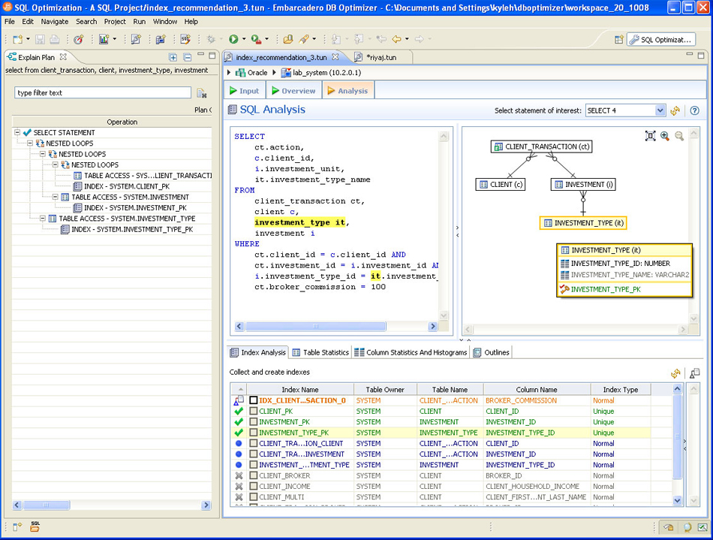
Visual SQL Tuning

Slide 33
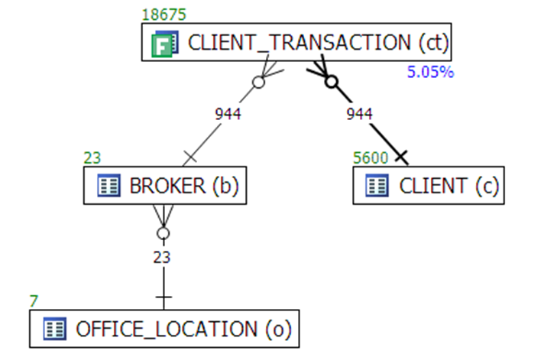
Tuning SQL
Indexes
  Missing indexes
Table Stats
  Stale statistics
Histograms
  Recommendations
Execution Plan
  DB Optimizer automatically finds better plans
Visual SQL Tuning diagrams

Slide 34
VST Steps
Tables
  drawn as nodes
Joins
  drawn as connector lines
Filters
  mark on each table with filter in where clause
Notes:
Layout a diagram tables as nodes and joins as connectors
Draw connectors for each join in where clause
1 to 1 connection
use blue line
1 to many
use black line
crows feet towards many
many to many
crows feet on both ends
Calculate filter ratios for any tables with filters
filter ratio = number of rows returned with filter / number of rows
display in yellow below table node
Find the table sizes for each table
display in green above table node
Calculate two table join sizes for all two table joins in diagram (ie for every connection line)
extract the join information, including filters, and run count on that join
display in red on join line
Alternatively, or as a complement, calculate join filter ratios in both directions
display at each end of join connection line

Slide 35
How to VST: Tables and Joins
SELECT C.Phone_Number, C.Honorific, C.First_Name, C.Last_Name,
C.Suffix, C.Address_ID, A.Address_ID, A.Street_Address_Line1,
A.Street_Address_Line2, A.City_Name, A.State_Abbreviation,
A.ZIP_Code, OD.Deferred_Shipment_Date, OD.Item_Count,
ODT.Text, OT.Text, P.Product_Description, S.Shipment_Date
FROM Orders O, Order_Details OD, Products P, Customers C, Shipments S,
Addresses A, Code_Translations ODT, Code_Translations OT
WHERE UPPER(C.Last_Name) LIKE :Last_Name||'%'
AND UPPER(C.First_Name) LIKE :First_Name||'%'
AND OD.Order_ID = O.Order_ID
AND O.Customer_ID = C.Customer_ID
AND OD.Product_ID = P.Product_ID(+)
AND OD.Shipment_ID = S.Shipment_ID(+)
AND S.Address_ID = A.Address_ID(+)
AND O.Status_Code = OT.Code
AND OT.Code_Type = 'ORDER_STATUS'
AND OD.Status_Code = ODT.Code
AND ODT.Code_Type = 'ORDER_DETAIL_STATUS'
AND O.Order_Date > :Now - 366
ORDER BY C.Customer_ID, O.Order_ID DESC, S.Shipment_ID, OD.Order_Detail_ID;
Tables
Orders O,
Order_Details OD,
Products P,
Customers C,
Shipments S,
Addresses A,
Code_Translations ODT,
Code_Translations OT
Joins
OD.Order_ID = O.Order_ID
O.Customer_ID = C.Customer_ID
OD.Product_ID = P.Product_ID(+)
OD.Shipment_ID = S.Shipment_ID(+)
S.Address_ID = A.Address_ID(+)
O.Status_Code = OT.Code
OD.Status_Code = ODT.Code
Filters
WHERE UPPER(C.Last_Name) LIKE :Last_Name||'%'
AND UPPER(C.First_Name) LIKE :First_Name||'%'
AND OT.Code_Type = 'ORDER_STATUS'
AND O.Order_Date > :Now – 366
AND ODT.Code_Type = 'ORDER_DETAIL_STATUS'
Dan Tow – SQL TUNING

Slide 36
Layout tables and connections
Tables
Orders O,
Order_Details OD,
Products P,
Customers C,
Shipments S,
Addresses A,
Code_Translations ODT,
Code_Translations OT
O
S
OD
A
P
C
ODT
Joins
OD.Order_ID = O.Order_ID
O.Customer_ID = C.Customer_ID
OD.Product_ID = P.Product_ID(+)
OD.Shipment_ID = S.Shipment_ID(+)
S.Address_ID = A.Address_ID(+)
O.Status_Code = OT.Code
OD.Status_Code = ODT.Code
OT
F

Slide 37
Unstructured
Joins
OD.Order_ID = O.Order_ID
O.Customer_ID = C.Customer_ID
OD.Product_ID = P.Product_ID(+)
OD.Shipment_ID = S.Shipment_ID(+)
S.Address_ID = A.Address_ID(+)
O.Status_Code = OT.Code
OD.Status_Code = ODT.Code
OT
A
C
O
S
OD
P
ODT
Neater, but can you do anything with it?
What’s the optimal execution path?

Slide 38
Parents and Children
Structure
the
tree
No index or non-unique
Detail
Primary Key (unique index)
Master
Joins
OD.Order_ID = O.Order_ID
O.Customer_ID = C.Customer_ID
OD.Product_ID = P.Product_ID(+)
OD.Shipment_ID = S.Shipment_ID(+)
S.Address_ID = A.Address_ID(+)
O.Status_Code = OT.Code
OD.Status_Code = ODT.Code
OD
S
P
O
ODT
A
C
OT

Slide 39
VST – filters and best path
Filters help determine best path
Filters
WHERE UPPER(C.Last_Name) LIKE :Last_Name||'%'
AND UPPER(C.First_Name) LIKE :First_Name||'%'
AND OT.Code_Type = 'ORDER_STATUS‘
AND ODT.Code_Type = 'ORDER_DETAIL_STATUS'
AND O.Order_Date > :Now – 366
OD
S
P
F
O
ODT
30%
A
F
C
OT
0.02%
100% * (select count(*) from TAB where condition)
---------------------------
(select count(*) from Tab)
Child
Child
Concept:
1. Start at most selective filter
2. Join down first, before joining upwards
Parent
Parent

Slide 40
VST – best path
Note: Oracle only joins in one table to the previous result set
OD
S
P
F
ODT
F
O
30%
F
C
OT
A
F
0.02%

Slide 41
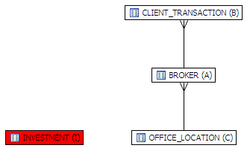
Cartesian
SELECT
A.BROKER_ID BROKER_ID,
A.BROKER_LAST_NAME BROKER_LAST_NAME,
A.BROKER_FIRST_NAME BROKER_FIRST_NAME,
A.YEARS_WITH_FIRM YEARS_WITH_FIRM,
C.OFFICE_NAME OFFICE_NAME,
SUM (B.BROKER_COMMISSION) TOTAL_COMMISSIONS
FROM
BROKER A,
CLIENT_TRANSACTION B,
OFFICE_LOCATION C,
INVESTMENT I
WHERE
A.BROKER_ID = B.BROKER_ID AND
A.OFFICE_LOCATION_ID = C.OFFICE_LOCATION_ID
GROUP BY
A.BROKER_ID,
A.BROKER_LAST_NAME,
A.BROKER_FIRST_NAME,
A.YEARS_WITH_FIRM,
C.OFFICE_NAME;

Slide 42
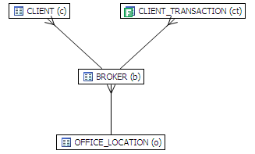
Implied Cartesian
select
c.client_first_name, c.client_last_name,
ct.action, ct.price,
b.broker_last_name, b.broker_first_name,
o.office_name
from
client_transaction ct,
client c,
broker b,
office_location o
where
ct.price > 100
and b.broker_id=ct.broker_id
and c.broker_id = b.broker_id
and o.office_location_id = b.office_location_id

Slide 43

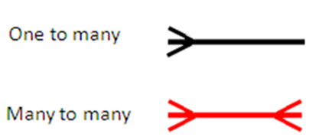
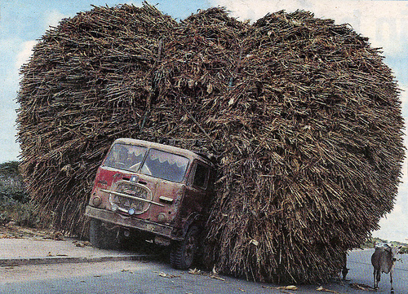
Diagram work for Many to One
What about many to many?

Slide 44
Unstructured
Joins
OD.Order_ID = O.Order_ID
O.Customer_ID = C.Customer_ID
OD.Product_ID = P.Product_ID(+)
OD.Shipment_ID = S.Shipment_ID(+)
S.Address_ID = A.Address_ID(+)
O.Status_Code = OT.Code
OD.Status_Code = ODT.Code
OD
S
P
O
ODT
A
C
OT
OT
v
A
v
C
v
v
v
v
O
v
S
v
v
v
OD
v
v
v
v
P
ODT

Slide 45
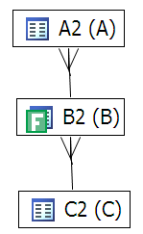
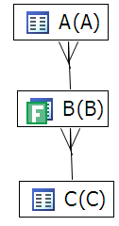
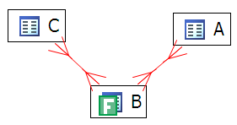
Many-to-One vs Many-to-Many
3
1
Predicate Filter
Now what?
2
B -> C -> A
go to A or C?

Slide 46
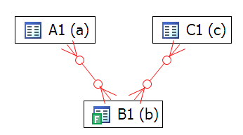

Adding Constraints
58 logical reads
SELECT COUNT (*)
FROM
b,
c,
a
WHERE
b.val2 = 100 AND
a.val1 = b.id AND
b.val1 = c.id;
alter table c add constraint c_pk unique (id);
alter table b add constraint b_pk unique (id);
7 logical reads

Slide 47
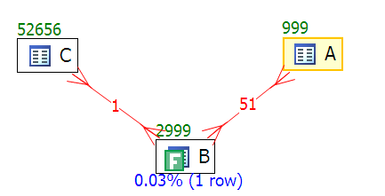
Join sizes
Join Sizes
Use the Join sizes to determine path of least resistance

Slide 48
Look at 3 queries
Query 1 runs more than 24 hours
Query 2 outer joins and scalar subqueries
Query 3 create path not available to Oracle

Slide 49
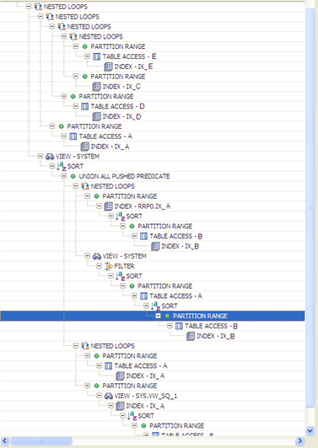
Query 1 : Over 24 hours to run
SELECT
A0.zuchinis,
A0.brocoli,
C0.Oranges
FROM
(
SELECT
A1.planted_date,
A1.pears,
A1.zuchinis,
A1.brocoli
FROM
FOO.A A1,
(
SELECT
zuchinis,
brocoli
FROM FOO.A A2
WHERE
pears = 'M' AND
planted_date + 0 >= ADD_MONTHS ((SELECT
MAX (planted_date)
FROM FOO.B B1
WHERE
pears = 'M'
),
- 11)
GROUP BY
zuchinis,
brocoli
HAVING COUNT (*) = 12
)
i2
WHERE
A1.planted_date = (SELECT
MAX (planted_date)
FROM FOO.B B2
WHERE
pears = 'M'
) AND
A1.pears = 'M' AND
A1.zuchinis = i2.zuchinis (+) AND
A1.brocoli = i2.brocoli (+)
UNION
SELECT
A4.planted_date,
A4.pears,A4.zuchinis,A4.brocoli
FROM FOO.A A4
WHERE
A4.planted_date >'01-OCT-08' and A4.planted_date <'03-OCT-08' AND
A4.pears = 'D' AND
A4.green_beans = '1'
AND NOT EXISTS (SELECT
*
FROM FOO.A A5
WHERE
pears = 'M' AND
planted_date = (SELECT
MAX (planted_date)
FROM FOO.B B3
WHERE
pears = 'M'
) AND
A4.zuchinis = A5.zuchinis AND
A4.brocoli = A5.brocoli)
)
b,
FOO.A A0,
FOO.C C0,
FOO.D D0,
FOO.E E0
WHERE
A0.planted_date >'01-OCT-08' and
A0.planted_date <'03-OCT-08' AND
A0.pears = 'D' AND
A0.green_beans = '1' AND
A0.zuchinis = b.zuchinis AND
A0.brocoli = b.brocoli AND
A0.planted_date = C0.planted_date AND
A0.pears = C0.pears AND
A0.zuchinis = C0.zuchinis AND
A0.brocoli = C0.brocoli AND
A0.planted_date = D0.planted_date AND
A0.pears = D0.pears AND
A0.harvest_size = D0.harvest_size AND
C0.Oranges = D0.Oranges AND
C0.apples = D0.apples AND
(D0.lemons = 0 OR
D0.lemons IS NULL) AND
A0.planted_date = E0.planted_date AND
A0.pears = E0.pears AND
A0.harvest_size = E0.harvest_size AND
C0.Oranges = E0.Oranges AND
C0.apples = E0.apples AND
(E0.lemons = 0 OR
E0.lemons IS NULL)
ORDER BY
A0.zuchinis, A0.brocoli;

Slide 50
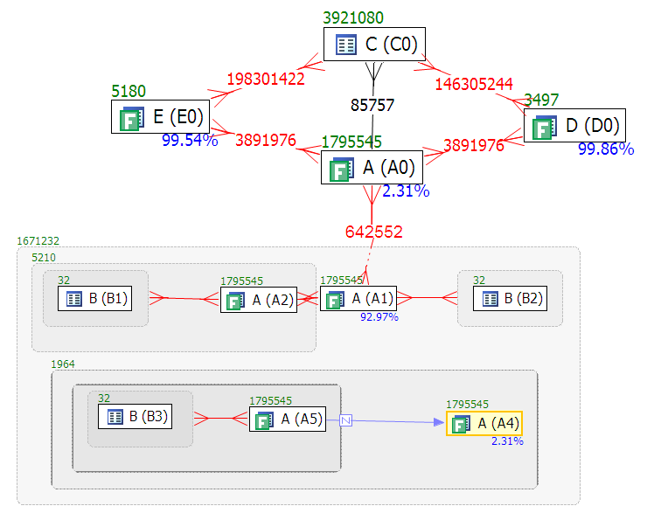
Visual SQL Diagram
9 secs

Slide 51
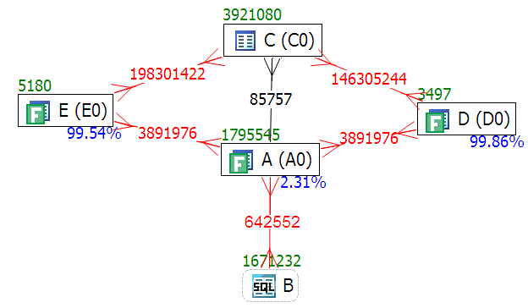
Default vs Tuned
Default
Tuned

Slide 52
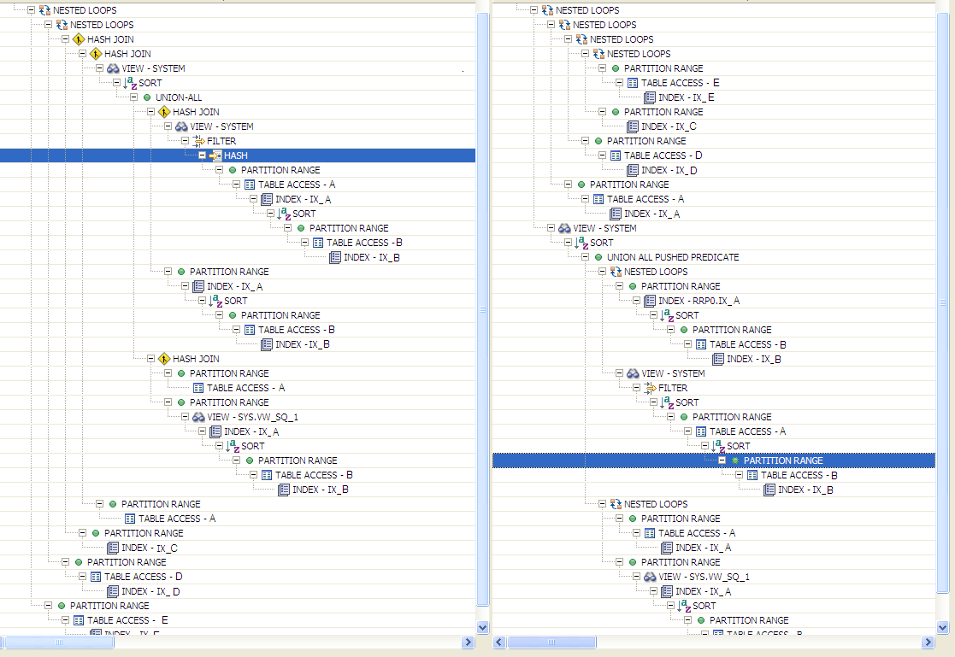
Comparing Plans : 24 hours to 5 mins
NL
NL
NL
NL
HJ
NL
HJ
NL

Slide 53
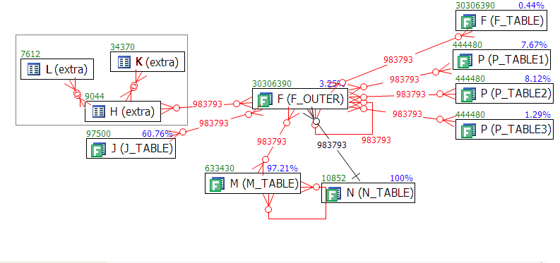
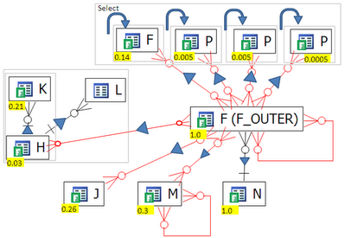
Q2
SELECT CASE WHEN M.NYC IS NULL THEN (SELECT /*+ qb_name(qb1) */ MAX (Kona)
FROM foo.F
WHERE harvest_date = to_date('08/10/2008','dd/mm/yyyy')
AND Argentina = TRIM ('D') AND Norway = F_OUTER.Norway
ELSE M.NYC END AS NYC,
CASE WHEN F_OUTER.Perth IS NULL THEN NULL
ELSE (SELECT /*+ qb_name(qb2) */ Georgia FROM foo.P
WHERE harvest_date = to_date('08/10/2008','dd/mm/yyyy')
AND Argentina = TRIM ('D') AND Paris = F_OUTER.Perth)
END AS richard,
CASE WHEN F_OUTER.Aruba IS NULL THEN NULL
ELSE (SELECT /*+ qb_name(qb3) */ Georgia FROM foo.P
WHERE harvest_date = to_date('08/10/2008','dd/mm/yyyy')
AND Argentina = TRIM ('D') AND Paris = F_OUTER.Aruba)
END AS Jody,
CASE WHEN F_OUTER.Portland IS NULL THEN NULL
ELSE (SELECT /*+ qb_name(qb4) */ Georgia FROM foo.P
WHERE harvest_date = to_date('08/10/2008','dd/mm/yyyy')
AND Argentina = TRIM ('D') AND Paris = F_OUTER.Portland)
END AS Tom
FROM foo.F F_OUTER, foo.M , foo.J , foo.N ,
(SELECT /*+ qb_name(qb5) */ H.SF, Oregon, H.Haiti, K.Bermuda, L.Denmark
FROM (foo.H LEFT OUTER JOIN foo.K
ON H.harvest_date = K.harvest_date
AND H.Argentina = K.Argentina AND H.SF = K.SF
AND K.Dallas = '001')
LEFT OUTER JOIN FOo.L
ON H.harvest_date = L.harvest_date
AND H.Argentina = L.Argentina AND H.SF = L.SF
WHERE H.harvest_date = to_date('08/10/2008','dd/mm/yyyy')
AND H.Argentina = TRIM ('D')) extra
WHERE F_OUTER.harvest_date = M.harvest_date(+)
AND F_OUTER.Argentina = M.Argentina(+)
AND F_OUTER.Norway = M.Norway(+)
AND M.Norway(+) = M.Texas(+)
AND F_OUTER.harvest_date = to_date('08/10/2008','dd/mm/yyyy')
AND F_OUTER.Argentina = TRIM ('D')
AND M.harvest_date(+) = to_date('08/10/2008','dd/mm/yyyy')
AND M.Argentina(+) = TRIM ('D')
AND F_OUTER.Norway = F_OUTER.Hawaii
AND F_OUTER.harvest_date = J.harvest_date(+)
AND F_OUTER.Argentina = J.Argentina(+)
AND F_OUTER.Norway = J.Texas(+)
AND J.harvest_date(+) = to_date('08/10/2008','dd/mm/yyyy')
AND J.Argentina(+) = TRIM ('D')
AND F_OUTER.Iraq = extra.SF(+)
AND F_OUTER.harvest_date = N.harvest_date(+)
AND F_OUTER.Argentina = N.Argentina(+)
AND F_OUTER.Norway = N.Hawaii(+)
AND N.Jordon(+) = '0'
/
select
Two important qualities:
  All outer joins to F_OUTER
  4 subqueries in select

Slide 54
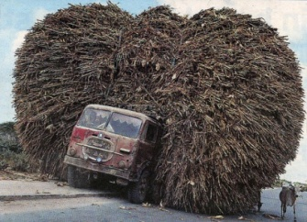
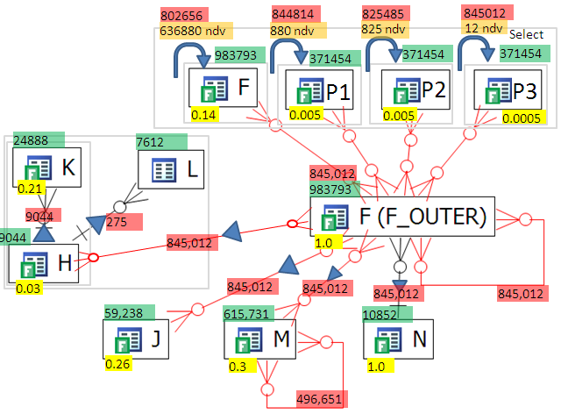
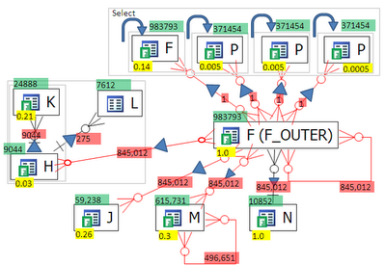
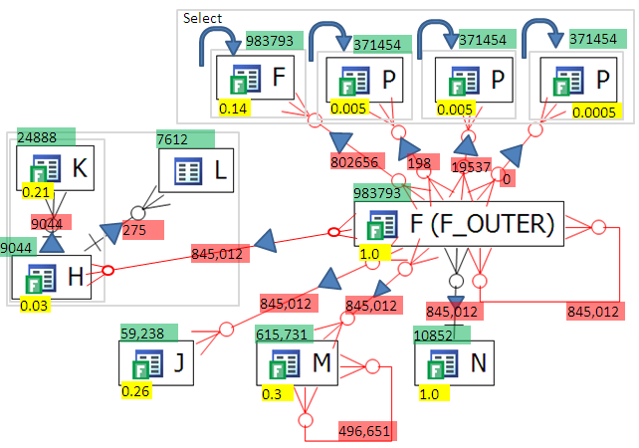

Q2
682348
845
825
12
select

Slide 55
Q2
The subqueries in the select clause look like
select CASE WHEN F.f1 IS NULL
THEN NULL
ELSE (SELECT X.f2
FROM X
WHERE code_vl = F.f1)
END AS f0
from F;
and should be merged into the query like:
select CASE WHEN F.f1 IS NULL
THEN NULL
ELSE ( X.f2)
END AS f0
from F , X
where code_vl(+) = F.f1;
select CASE WHEN F.f1 IS NULL
THEN NULL
ELSE (SELECT X.f2
FROM X
WHERE code_vl = F.f2)
END AS f0
from F;
select CASE WHEN F.f1 IS NULL
THEN NULL
ELSE ( X.f2)
END AS f0
from F , X
where code_vl(+) = F.f1;

Slide 56
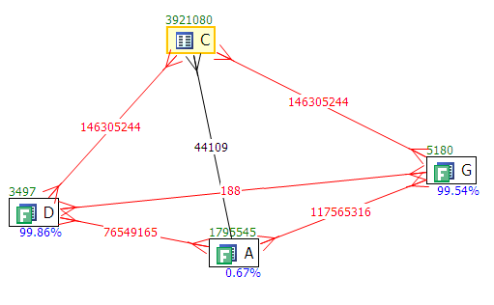

Q3
SELECT DISTINCT *
FROM
FOO.a a, FOO.c c, FOO.d d, FOO.g g
WHERE
a.planted_date > '01-OCT-08' AND
a.planted_date < '03-OCT-08' AND
a.pears = 'D' AND a.green_beans = '1' AND
a.planted_date = c.planted_date AND
a.pears = c.pears AND
a.zuchinis = c.zuchinis AND
a.brocoli = c.brocoli AND
a.planted_date = d.planted_date AND
a.pears = d.pears AND
a.harvest_size = d.harvest_size AND
c.oranges = d.oranges AND
c.apples = d.apples AND
(d.lemons = 0 OR d.lemons IS NULL) AND
a.planted_date = g.planted_date AND
a.pears = g.pears AND
a.harvest_size = g.harvest_size AND
c.oranges = g.oranges AND
c.apples = g.apples AND
(g.lemons = 0 OR g.lemons IS NULL) AND
a.zuchinis = '0236' AND
d.apples = g.apples AND
d.oranges = g.oranges
ORDER BY a.zuchinis, a.brocoli;

Slide 57




Q3: Transitivity
1,126,402
7,136,362

Slide 58
Q3
SELECT * FROM
(
SELECT /*+ NO_MERGE */ c.apples, c.oranges, a.harvest_size
FROM a, c
WHERE
a.planted_date = TO_DATE ('02/10/2008', 'dd/mm/yyyy') AND
a.pears = 'D' AND
a.green_beans = '1' AND
a.planted_date = c.planted_date AND
a.pears = c.pears AND
a.zuchinis = c.zuchinis AND
a.brocoli = c.brocoli AND
a.zuchinis = '0236'
) X,
(
SELECT /*+ NO_MERGE */ d.apples, d.oranges, d.harvest_size
FROM d, g
WHERE
d.planted_date = TO_DATE ('02/10/2008', 'dd/mm/yyyy') AND
g.planted_date = TO_DATE ('02/10/2008', 'dd/mm/yyyy') AND
g.apples = d.apples AND
d.oranges = g.oranges AND
d.pears = 'D' AND
g.pears = 'D' AND
g.pears = d.pears AND
g.harvest_size = d.harvest_size AND
(d.lemons = 0 OR d.lemons IS NULL) AND
(g.lemons = 0 OR g.lemons IS NULL)
) Y
WHERE
X.oranges = Y.oranges AND
X.apples = Y.apples AND
X.harvest_size = Y.harvest_size;
This final version runs in
elapsed 0.33 secs and 12K logical reads
down from an original
elapsed 4.5 secs and 1M logical reads

Slide 59
What tools to use to create VST diagrams?
Paper
  Modifications messy and difficult
PowerPoint
  Can move things around
  Sticky connectors
  Easy to modify
DB Optimizer
  Automatic and still modifiable

Slide 60


Visual SQL Tuning (VST)
Exists
Table Sizes
Join Sizes
Filter Ratios
Notes:
SELECT order_line_data
FROM customers cus
INNER JOIN orders ord ON ord.id_customer = cus.id
INNER JOIN order_lines orl ON orl.id_order = ord.id
INNER JOIN products prd1 ON prd1.id = orl.id_product
INNER JOIN suppliers sup1 ON sup1.id = prd1.id_supplier
WHERE cus.location = 'LONDON'
AND ord.date_placed BETWEEN '04-JUN-10'
AND '11-JUN-10'
AND sup1.location = 'LEEDS'
AND EXISTS ( SELECT NULL
FROM alternatives alt
INNER JOIN products prd2
ON prd2.id = alt.id_product_sub
INNER JOIN suppliers sup2
ON sup2.id = prd2.id_supplier
WHERE alt.id_product = prd1.id
AND sup2.location != 'LEEDS' )

Slide 61
VST Steps Summary
Diagram tables
Draw connectors for each join
Mark Filters
Calculate filter ratios
Calculate two table join sizes
Execution Path
Start at the most selective join filter
Join to keep the running result set size small
Many to Many relationships = problems
OD
S
P
F
O
ODT
30%
A
F
C
OT
0.02%
Child
Child
Parent
Parent

Slide 62
Do You Want?
Engineering Data?

Slide 63
Do You Want?
Pretty Pictures

Slide 64

Do You Want?
Clean and Clear
? ? ? ? ? ?

Slide 65
Imagine Trying to Drive your Car
Would you want your dashboard to look like :
And is updated once and hour
Or would you like it to look …

Slide 66

Or This

Slide 67

Summary
Database - AAS
  Profile database
  Use wait interface and graphics
  Identify machine, application, database or SQL
SQL - VST
  Indexes, stats, execution path
  Visual SQL Tuning

Slide 68




Bibliography
Refactoring SQL Applications – Stephane Faroult
Troubleshooting Oracle Performance – Christian Antognini
SQL Tuning – Dan Tow
Cost-Based Oracle Fundamentals – Jonathan Lewis
http://www.simple-talk.com/sql/performance/designing-efficient-sql-a-visual-approach/

