Slide 1

Workload Management for an Operational DW
Oracle Database 11g Release 2
Jean-Pierre Dijcks
Data Warehouse Product Management

Slide 2
Agenda
What is a Mixed Workload?
Planning for Workload Management
  Getting Ready
  Tools and Methods
Technical Details
A Small Example
Q&A

Slide 3


<Insert Picture Here>
What is a Mixed Workload?

Slide 4

A Mixed Workload
Major Changes for your Data Warehouse
Department A supplies data to the DW daily and runs reports
Department B supplies data to the DW daily and runs reports
10101000101
10101000101
10101000101
10101000101
Enterprise Data Warehouse
Daily batch windows
Ad-hoc queries
Downtime OK

Slide 5
A Mixed Workload
Major Changes for your Data Warehouse
All Departments
On-Line Applications
CEO
Strategy
Finance
Marketing
CRM Live Systems
Stock Tracking
Direct Business Impact
10101000101
10101000101
10101000101
10101000101
Real Time
Feeds
Enterprise Data Warehouse
Write-Backs
Classic Reporting
10101000101
10101000101
Deep Analytics
10101000101
10101000101
Long running reports
Heavy Analytical Content
Investigative querying
Predictive Modeling
Scenario Analysis
Data Mining

Slide 6
A Mixed Workload
Major Changes for You
Changed Workload
More concurrent users
Continuous data loads
High priority, must run now queries
Larger data volumes
Changed Focus
Focus on Workload Management
Focus on Resource Management
De-emphasize single statement tuning

Slide 7
<Insert Picture Here>
Planning for Workload
Management
Getting Ready

Slide 8
Workload Management for DW
Three Main Components
Workload
Management
Database
Architecture
Hardware
Architecture
Define Workload Plans
Filter Exceptions
Manage Resources
Monitor Workloads
Adjust Workload Plans
EDW Data Layers
Data Mart Strategy
Sandboxes
Active HA/DR Strategy
Compression Strategies
Storage Media Hierarchy
✓
✓
✓
✓
✓
✓
✓
✓
✓
✓
✓

Slide 9

Workload Management for DW
What we are covering today…
Workload
Management
Define Workload Plans
Define Workloads
Filter Exceptions
Manage Resources
Monitor Workloads
Adjust Plans
Execute Workloads
Monitor Workloads
Adjust Workload Plans
RAC
OEM
IORM
DBRM
Notes:
The RAC piece includes things like:
Services
Server Pools (Grid Infrastructure) to provide elasticity (add servers to pool to increase memory)
Instance Caging (consolidation)

Slide 10
Step 1: Understand the Workload
Review the workload to find out:
  Who is doing the work?
  What types of work are done on the system?
  When are certain types being done?
  Where are performance problem areas?
  What are the priorities, and do they change during a time window?
  Are there priority conflicts?

Slide 11
Step 2: Map the Workload to the System
Create the required Resource Plans:
  For example: Nighttime vs. daytime, online vs. offline
Create the resource groups:
  Map to users
  Map to estimated execution time
  Etc
Set the overall priorities
  Which resource group gets most resources
  Cap max utilizations
Drill down into parallelism, queuing and session throttles

Slide 12
Step 3: Run and Adjust the Workload
Run a workload for a period of time and look at the results
DBRM Adjust:
  Overall priorities
  Scheduling of switches in plans
  Queuing
System Adjust:
  How many PX statements
  PX Queuing levels vs. Utilization levels (should we queue less?)

Slide 13
<Insert Picture Here>
Planning for Workload
Management
Tools and Methods

Slide 14
Tools and Methods
What to use when and what to worry about
Services and Server Pools
  Used in a RAC environment
  Server Pools are relatively new
Database Resource Manager
  Policy based Resource management
  Thresholds and Actions
Automatic DOP and Statement Queuing
  Ensuring parallel queries do not flood the system

Slide 15
Services
1
2
3
4
5
6
7
8
Service Gold
Service Silver
Known concept
Use services to restrict the number of nodes
Divide 8 Node cluster, where Service Gold is 3 nodes

Slide 16
Services and Server Pools
1
2
3
4
5
6
7
8
Service Gold
Service Silver
Expand a service by expanding the pool of servers it has access to
Expand Service Gold to 4 nodes
Shrink Service Silver to 4 nodes

Slide 17
DBRM Provides
Single framework to do workload management including
  CPU
  Session control
  Thresholds
  IO (Exadata has IO Resource Manager)
  Parallel statement queuing
Each consumer group now needs to be managed in terms of parallel statement queuing
New settings / screens to control queuing in Enterprise Manager and in DBRM packages

Slide 18
Database Resource Manager
1
2
3
4
5
6
7
8
Grp 1
Grp 2
Grp 3
Divide a system horizontally across nodes
Uses Resources Plans and Groups to model and assign resources
Allows for prioritization and flexibility in resource allocation

Slide 19
Database Resource Manager
1
2
3
4
5
6
7
8
Grp 1
Grp 3
Grp 2
Grp 4
Grp 5
Service Gold
Service Silver
Can be service aware
Make sure to fully utilize the resources
Services can be assigned to resource groups

Slide 20
Mixed Workloads and Parallel Execution?
Mixed Workload Challenges
Too many workloads and user to do manual tuning
One DOP does not fit all queries touching an object (write, read etc.)
Not enough PX server processes can result in statement running serial leading to unexpected runtime degradations
Too many PX server processes can thrash the system causing priority queries to not run
11g Release 2 Enhancements
Oracle automatically decides if a statement
  Executes in parallel or not and what DOP it will use
  Can execute immediately or will be queued
Notes:
Prior to 11gR2 customers had to manual determine what DOP a statement should run with.
With no clear guide on how to determine the ideal DOP, customers would generally decide
on a DOP for an object (table, index) and all statements accessing that object would use
the same DOP. But one DOP may not be suitable for all statements.
The only other alternative was to use a different PARALLEL hint for each statement, but a
lot of third-party applications do not allow hints to be used and even if you could put a
hint for every statement it would mean a time consuming tuning exercise every time a
new statement got added to the system.
In 11gR2 Oracle automatically decides if a statement should execute in parallel or not
and what DOP it should use. Oracle will also decide if the statement can execute
immediately or if it should be queued until more system resources are available.
Finally Oracle will decide if the statement can take advantage of the aggregated cluster
memory or not (IN-Memory PQ)

Slide 21
Autmatic DOP, Queuing and DBRM?
PX Mixed Workload Benefits
Varying DOPs per object per task without manual intervention
More processes going in parallel allowing faster overall execution times
Database managed queuing to allow higher DOPs without thrashing the system
PX and DBRM Benefits
Dynamic usage of resources by monitoring the entire system
Different users can get more or less resources based on priorities without statement level tuning
Comprehensive management reducing incident management
Notes:
Prior to 11gR2 customers had to manual determine what DOP a statement should run with.
With no clear guide on how to determine the ideal DOP, customers would generally decide
on a DOP for an object (table, index) and all statements accessing that object would use
the same DOP. But one DOP may not be suitable for all statements.
The only other alternative was to use a different PARALLEL hint for each statement, but a
lot of third-party applications do not allow hints to be used and even if you could put a
hint for every statement it would mean a time consuming tuning exercise every time a
new statement got added to the system.
In 11gR2 Oracle automatically decides if a statement should execute in parallel or not
and what DOP it should use. Oracle will also decide if the statement can execute
immediately or if it should be queued until more system resources are available.
Finally Oracle will decide if the statement can take advantage of the aggregated cluster
memory or not (IN-Memory PQ)

Slide 22
<Insert Picture Here>
Technical Details
How it all really works…
Parallel Execution

Slide 23
Parameter Hierarchy
PX Features:
NONE
Parallel_degree_policy = Manual
  None of the parameters have any impact
Parallel_degree_policy = Limited
  Parallel_min_time_threshold = 10s
  Parallel_degree_limit = CPU
Parallel_degree_policy = Auto
  Parallel_min_time_threshold = 10s
  Parallel_degree_limit = CPU
  Parallel_servers_target = Set to Default DOP on Exadata
PX Features:
Auto DOP
PX Features:
Auto DOP
Queuing
In-Memory

Slide 24





Auto Degree of Parallelism
Enhancement addressing:
Difficult to determine ideal DOP for each table without manual tuning
One DOP does not fit all queries touching an object
Statement is hard parsed and optimizer determines the execution plan
Optimizer determines autoDOP based on all scan operations
SQL
statement
If estimated time greater than threshold*
Actual DOP = MIN(PARALLEL_DEGREE_LIMIT, autoDOP)
If estimated time less than threshold*
Statement executes in parallel
Statement executes serially
* Threshold set in parallel_min_time_threshold (default = 10s)
Notes:
When a SQL statement is executed it will be hard parsed and a serial plan will be developed
The expected elapse time of that plan will be examined. If the expected Elapse time is
Less than PARALLEL_MIN_TIME_THRESHOLD then the query will execute serially.
If the expected Elapse time is greater than PARALLEL_MIN_TIME_THRESHOLD then the plan
Will be re-evaluated to run in parallel and the optimizer will determine the ideal DOP. The
Optimizer automatically determines the DOP based on the resource required for all scan operations
(full table scan, index fast full scan and so on)
However, the optimizer will cap the actual DOP for a statement with the default DOP
(paralllel_threads_per_cpu X CPU_COUNT X INSTANCE_COUNT), to ensure parallel
Processes do not flood the system.

Slide 25
Parallel Statement Queuing
Enhancement addressing:
Not enough PX server processes can result in statement running serial
Too many PX server processes can thrash the system
Statement is parsed
and oracle automatically determines DOP
If not enough parallel servers available queue the statement
SQL
statements
64
32
64
16
32
128
16
FIFO Queue
When the required number of parallel servers become available the first stmt on the queue is dequeued and executed
If enough parallel servers available execute immediately
8
128
Notes:
Step 1: SQL Statement is issued and Oracle automatically determines if
It will run in parallel and if so what DOP it will get.
Step 2: Oracle checks to see if there are enough PQ servers to execute
The query. If there are it will execute immediately if there are not then
The query will be queued in a FIFO
Step 3: Everyone waits in the queue for the statement at the top of the
Queue to get all of his requested PQ servers even if there are enough
PQ servers available for one of the other statements to run ??????
Step 4: When enough PQ servers are available the statement is
De-queued and allowed to execute.

Slide 26
Parameters
Crucial for “all” 11g R2 PX features
Parameter | Default Value | Description
PARALLEL_DEGREE_POLICY | “MANUAL” | Specifies if Auto DOP, Queuing, & In-memory PE are enabled
PARALLEL_DEGREE_LIMIT | “CPU” | Max DOP that can be granted with Auto DOP
PARALLEL_MIN_TIME_THRESHOLD | “AUTO” | Specifies min execution time a statement should have before AUTO DOP will kick in
PARALLEL_SERVERS_TARGET | 4*CPU_COUNT* PARALLEL_THREADS_PER_CPU * ACTIVE_INSTANCES | Specifies # of parallel processes allowed to run parallel stmts before queuing will be use

Slide 27
Potential number of Parallel Statements
Controlled by parallel_min_time_threshold
Based on estimated execution time
Default = 10 seconds
Slide the bar to throttle…
0
60
120
180
Increase threshold
Fewer statements evaluated for PX
No impact on calculated autoDOP value

Slide 28
Preventing Extreme DOPs
Setting a system wide parameter
By setting parallel_degree_limit you CAP the maximum degree ANY statement can run with on the system
Default setting is Default DOP which means no statement ever runs at a higher DOP than Default DOP
Think of this as your safety net for when the magic fails and Auto DOP is reaching extreme levels of DOP
Note: EM will not show a downgrade for capped DOPs!

Slide 29
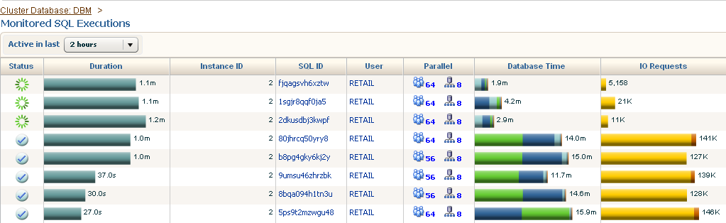
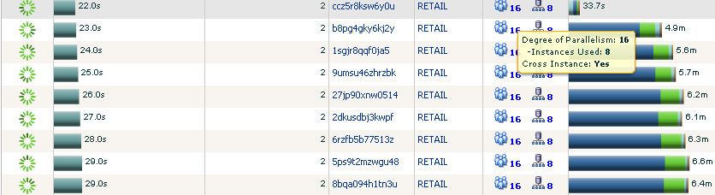
A workload with Auto DOP
Applying Degree Limit
Before
After Capping with Degree
Limit at DOP 16
Notes:
These are the same analytical queries that were shown in the initial slides. Manual tuning for this demo set the DOP at 48, Auto DOP calculated 56 or 64 as the best DOP. Runtimes are very similar with either 48 or 56

Slide 30
Parallel Statement Queuing
Pros:
  Allows for higher DOPs per statement without thrashing the system
  Allows a set of queries to run at roughly the same aggregate time by allowing the optimal DOP to be used all the time
Cons:
  Adds delay to your execution time if your statement is queued making elapse times more unpredictable
Your Goal:
  Find the optimal queuing point based on desired concurrency

Slide 31
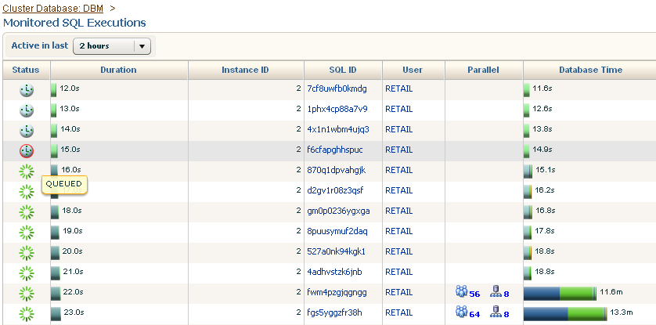
Queuing Shown in EM

Slide 32

Parallel Statement Queuing
Minimal Concurrency
Number
of
Parallel
Server
Processes
Queuing Starts
128
Parallel_servers_target
Minimal Concurrency
(conservative)
4
2
16
32
Parallel_degree_limit

Slide 33
Parallel Statement Queuing
Calculating Minimal Concurrency based on processes
Minimal concurrency is the minimal number of parallel statements than can run before queuing starts:
minimal concurrency =
The conservative assumption is that you always have producers and consumers (and not PWJ all the time)
Parallel_servers_target
× 0.5
Parallel_degree_limit

Slide 34
<Insert Picture Here>
Technical Details
How it all really works…
Database Resource Manager

Slide 35

Workload Management
Request
Each request:
Executes on a RAC Service
Which limits the physical resources
Allows scalability across racks
Assign
Each consumer group has:
Resource Allocation (example: 10% of CPU/IO resources)
Directives (example: 20 active sessions)
Thresholds (example: no jobs longer than 2 min)
Execute
Each request assigned to a consumer group:
OS or DB Username
Application or Module
Action within Module
Administrative function
Ad-hoc
Workload
Queue
Downgrade
Reject

Slide 36
Workload Management
Static Reports
Request
Queue
Assign
Tactical Queries
Queue
Execute
Ad-hoc
Workload
Queue
Downgrade
Reject

Slide 37
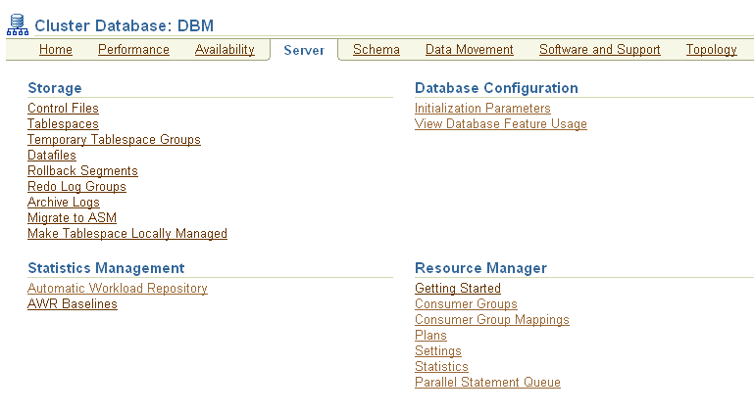
Resource Manager User Interface
New!

Slide 38
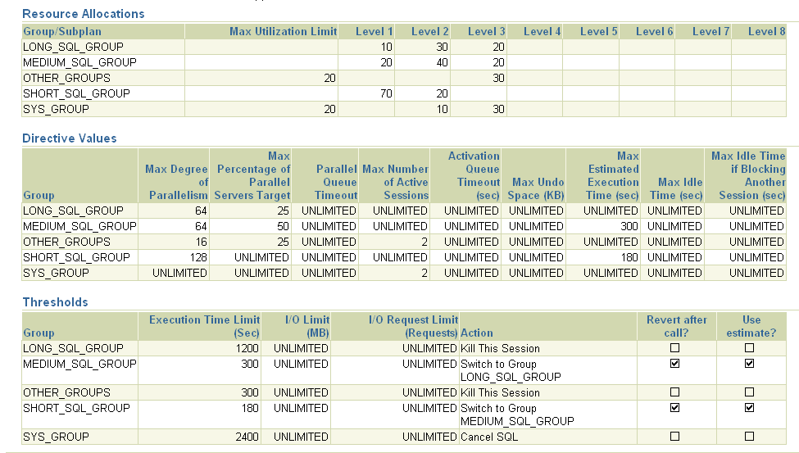
Consumer Group Settings Overview

Slide 39
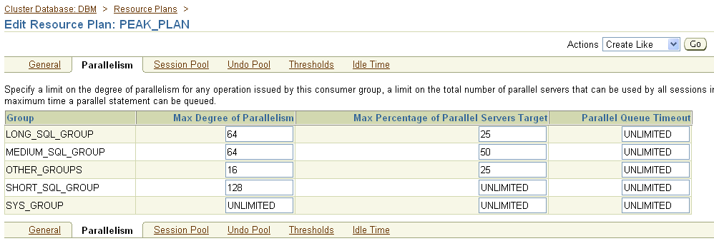
Manipulating PX Properties
Specify Max DOP
Specify resources before queuing
Specify queue timeouts

Slide 40
Statement Queuing Changes
25%
256
15%
Static Reports
Queue
Request
25%
256
Assign
20%
Tactical Queries
Queue
65%
50%
512
Ad-hoc
Workload
Queue
Set CPU and other Thresholds per Group
Determine Priorities
Queuing is embedded with DBRM
One queue per consumer group

Slide 41
<Insert Picture Here>
A Small Case Study

Slide 42
Case: Main Workload
Customer is implementing a DSS workload on a database machine. The machine is currently only used for the US based operations.
Operational hours are 6am EST until 12 midnight EST to service online call center access to the DSS system during the entire day (including for pacific and Hawaii time zone customers).
During these hours the load is mostly CRM app access into relatively large volumes of historical customer, order and historical user satisfaction information and Analytics access using Business Objects.
To ensure high customer satisfaction, CRM access is crucial and should never be blocked by any other queries.
Analytics are almost as important during the day as they will identify cross sales, however the queries are a lot more resource intensive and the users can wait longer for the results.

Slide 43
Case: Data Loading
Data loads are continuous for small reference data sets and for some small crucial updates to core data warehouse data. Most large loads are still run in the nightly batch window.
It is crucial that the nightly batch window is met so all data is up-to-date the next date. This will remain in place until a continuous load for all data is in place.
Typically no end users are on the system (or should be on the system) during ETL batch load windows.

Slide 44
Case: User Profiles
Based on the user communities that work on the system, the customer has done some of your homework already by identifying the user groups:
CRM users, identified by either their application type or usernames
BO Users, identified by their username used to query the DB => BO_ACCESS_USER
ETL batch jobs identified by their username for the DB => B_ETL
ETL trickle jobs identified by their username for the DB => T_ETL

Slide 45
Possible Solution
Create 2 resource plans for different periods during the day
Online plan
Batch plan
Step 1:
Step 2:
Context
Create 3 groups and ensure Others is in the plan
CRM
CRM
BO
BO_TR
T_ETL
Batch
Step 3:
B_ETL
Map “who” to the resource plans using username and app context
Others
Users
Notes:
BO_TR is the BO and trickle feed ETL resource group as they are similarly in importance… but there is nothing wrong with 4 groups…
Others comes by default and not having it in a plan causes an error…

Slide 46
Possible Solution
Add groups to the plans to ensure they can be set
Step 4:
Online plan
Batch plan
Level 1
MaxDOP
Level 2
Step 5:
CRM
90
4
Resource priorities for each group in a plan (note differs per plan)
10
70
BO_TR
32
10
Batch
Step 6:
16
Limit the DOPs for each of the groups per plan
Others
1
20
Notes:
BO_TR is the BO and trickle feed ETL resource group as they are similarly in importance… but there is nothing wrong with 4 groups…
Others comes by default and not having it in a plan causes an error…

Slide 47
Possible Solution
Online plan
Batch plan
Level 1
MaxDOP
%target
Level 2
Step 7:
CRM
90
4
70
Set queue levels for each the groups per plan
10
70
BO_TR
32
30
Batch
10
1
16
U
Step 8:
Others
Limit sessions (optional) for some of the groups per plan
20
1
1
U
Notes:
BO_TR is the BO and trickle feed ETL resource group as they are similarly in importance… but there is nothing wrong with 4 groups…
Others comes by default and not having it in a plan causes an error…

Slide 48
Possible Solution
Online plan
Batch plan
Level 1
MaxDOP
%target
Level 2
Step 9:
CRM
90
4
70
Set Thresholds per group and the action to be done (optional)
10
70
BO_TR
32
30
Batch
10
1
16
U
Cost estimate > 120 seconds switch groups
Others
20
1
1
U
Notes:
BO_TR is the BO and trickle feed ETL resource group as they are similarly in importance… but there is nothing wrong with 4 groups…
Others comes by default and not having it in a plan causes an error…

Slide 49

Questions
Notes:
49

