Slide 1

Deployment Agility Through
Tier Testing
Hanan Hit,
NoCOUG President 2009
Notes:
1

Slide 2
Agenda
Intro to testing
Load testing challenges
Tier load testing
Snapshot standby databases
Demonstration
Notes:
2

Slide 3
Confused?
So Are we.
ORION
Load Runner
Hammerora
Availability Testing
Rapid Bottleneck Identification
Oracle Application Testing Suite
Burn out testing
Real Application Testing
Notes:
3

Slide 4
Test and Validate
Why?
46 percent of users permanently or temporarily abandoned their relationship with a preferred site because of technical difficulties or performance problems.
Source: Jupiter Media Metrix Consumer Study
Notes:
4

Slide 5
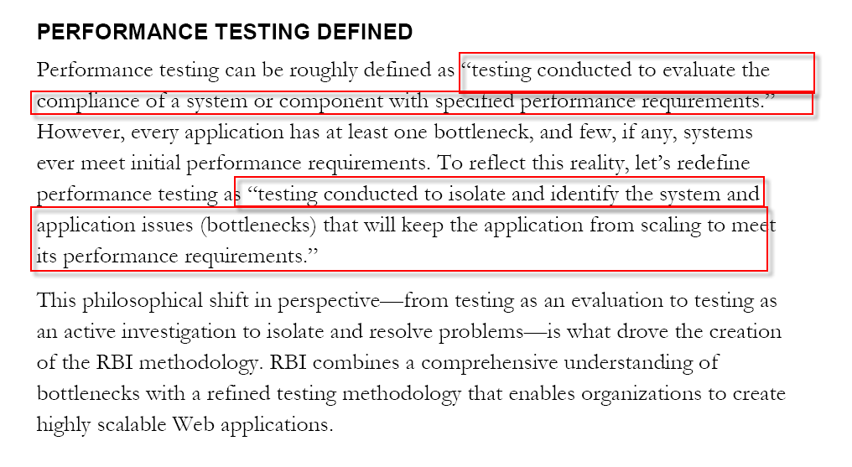
Performance Testing
Notes:
5

Slide 6
Load Testing Challenges
Test Development
Long development cycles for scripts and scenarios
Simulated data
Human resource intensive for test development
Automated data collection
Automatic parsing of data
Automatic script creation
100% reliable and authentic production data
Reduce scripting time
Notes:
6

Slide 7
Load Testing Challenges
Results Analysis
Data analysis after collection of data
Difficult to interpret results
Lots of expertise required
Integrated software for deep-dive analysis
Visual correlation across platforms, tiers, and clusters
Easy interpretation of results
Notes:
7

Slide 8
Throughput and Concurrency
Throughput
  The amount of data the system can support, measured in hits per second, pages per second and megabytes of data per second .
Concurrency
  Number of independent users simultaneously connected and using an application.
Notes:
8

Slide 9

Tier Load Testing
Diagnose by logical tiers
Create specific tests for application and database tiers
Infrastructure Tier
Application Tier
Database Tier
Load Test
Fire
wall
Load
Balancer
Fire
wall
Streaming
Media
Server
Storage
Web
Servers
Application
Servers
Database
Servers
Gather
Metrics
Measure Performance …
Notes:
9

Slide 10

Ex: Back-end Database Testing
Traditional Testing
New Testing Method
1,000s of vUsers
Back-end Concurrent Active Sessions
Database
Middle Tier
Less resources
UI independent
Less time
Concurrent Active Sessions
Database
Notes:
10

Slide 11
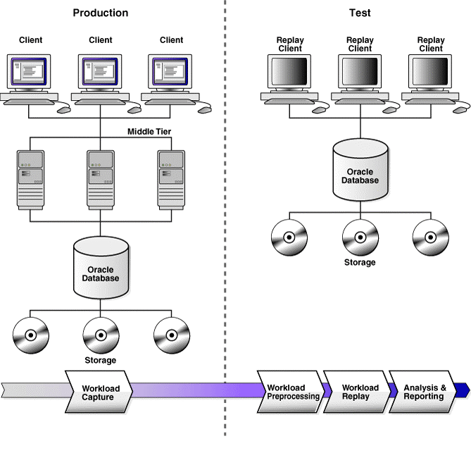
Database Replay Overview
Notes:
11

Slide 12
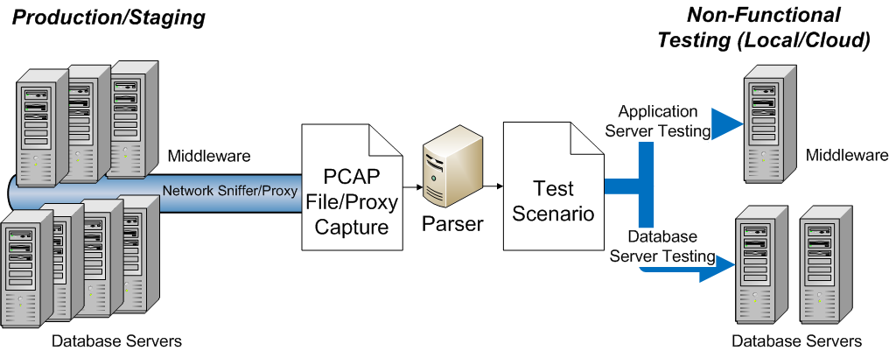
Test and Validate
100% authentic production load reproduction
Unified back-end and front-end load testing
Notes:
12

Slide 13
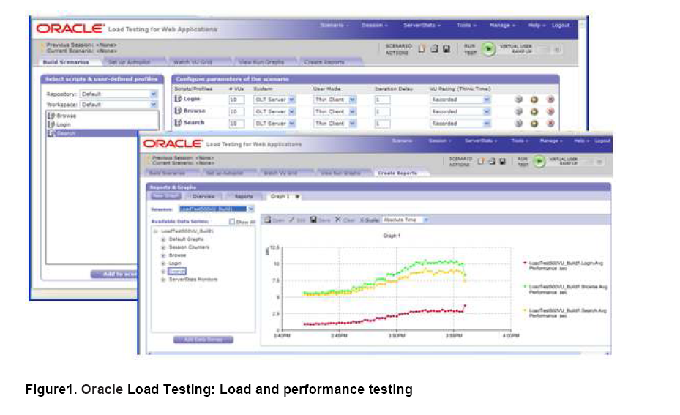
OATS
Notes:
13

Slide 14
Snapshot Standby Databases
Ability to open a physical standby database for testing or QA purposes while simultaneously collecting production changes for immediate application in case disaster recovery is required.
snapshot standby database still accepts redo information from its primary but it does not apply the redo to the database immediately; instead, the redo is only applied when the snapshot standby database is reconverted back into a physical standby
Notes:
14

Slide 15


Setting Up Test Environment Using Snapshot Standby Databases
Physical standby database
Redo
stream
Open database
Back out changes
Redo
stream
Perform testing
Snapshot standby database
SQL> ALTER DATABASE CONVERT TO SNAPSHOT STANDBY;
Notes:
15

Slide 16
Steps for Snapshot
Standby Load testing
Prerequisite –
  Oracle Database 11g installation (software and db installed) on 1 server and Oracle Database 11g software only on 2nd server
  Enable Flashback database on the Physical standby if not already enabled
Convert the Physical standby to a Snapshot standby
Verify that the redo is still being shipped to the standby
Execute Load test
Verify DML on few tables
Notes:
16

Slide 17
Steps for Snapshot Standby Load testing
Convert the snapshot standby back to a Physical standby
Switch logs on the primary
Stop the apply process when the standby is caught up with the primary
Open the physical standby database read only
Shutdown and restart physical standby
Restart the MRP process
Verify that the Snapshot changes no longer exist
Notes:
17

Slide 18
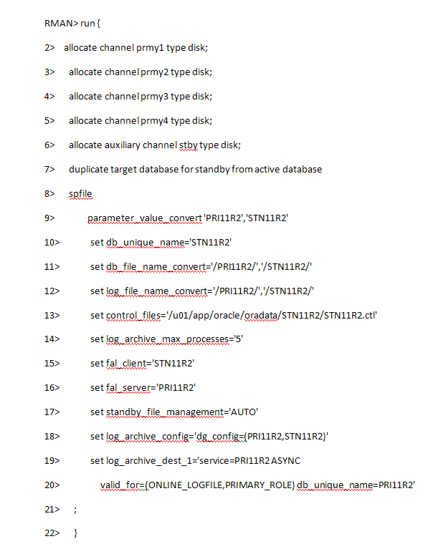
Creating Physical Standby with RMAN
Notes:
18

Slide 19
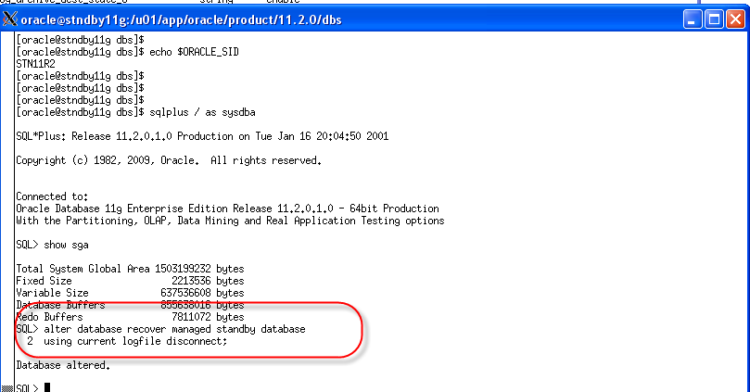
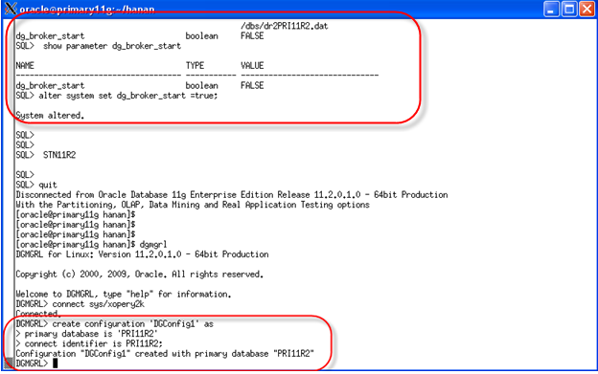
Start the MRP and Broker Creation
Standby
Primary
Notes:
19

Slide 20
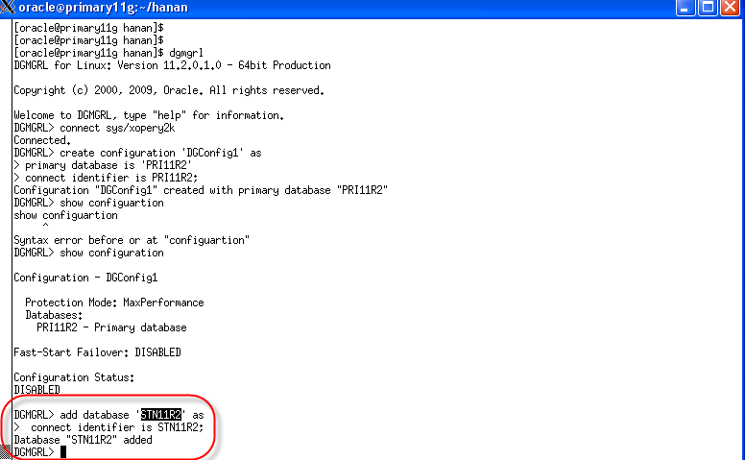
Add your physical standby database to the broker configuration
Notes:
20

Slide 21
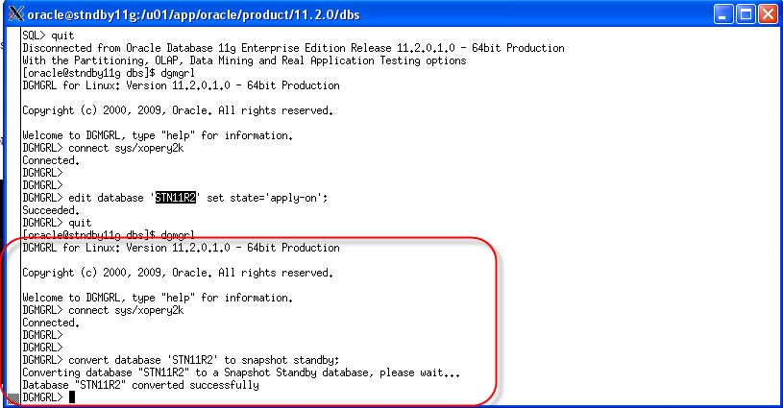
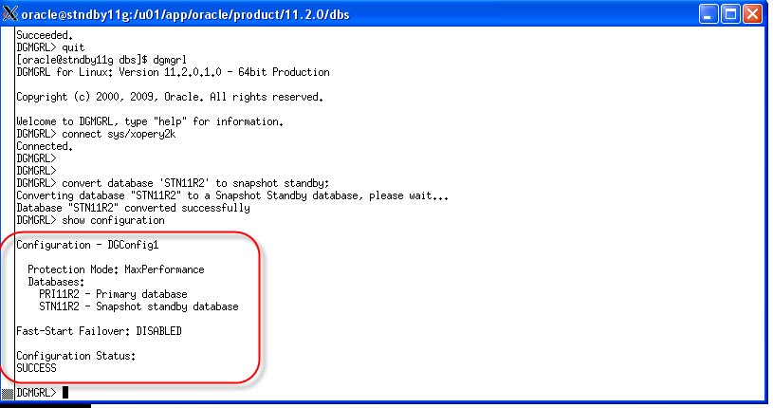
Convert the Physical Standby Database to a Snapshot Standby Database
Standby
Standby
Notes:
21

Slide 22
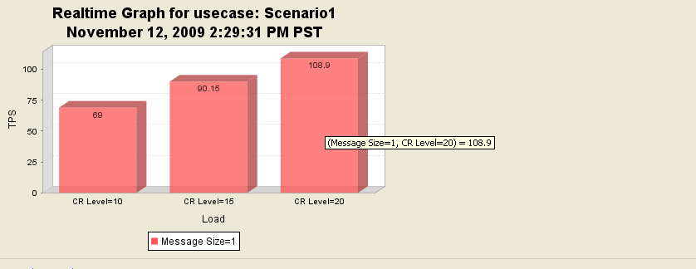
Execute Load Test
Notes:
22

Slide 23
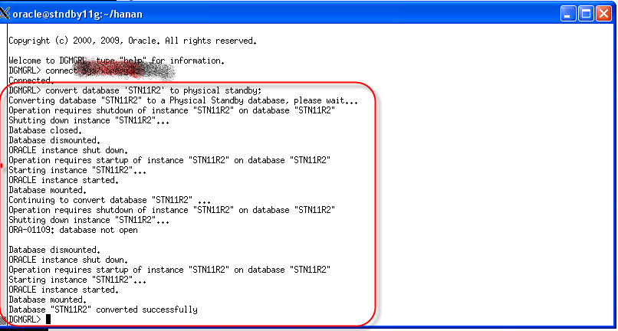
Converting the Snapshot Standby Database to a Physical Standby Database
Notes:
23

Slide 24
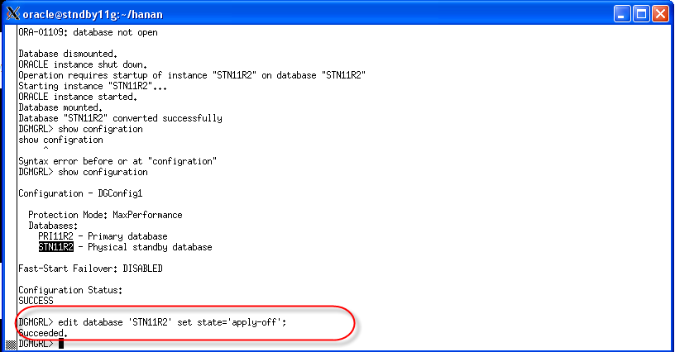
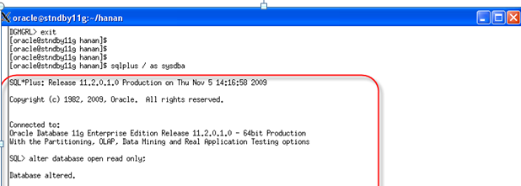
Stop the MRP and Open the physical standby database in read-only mode
Standby
Standby
Notes:
24

Slide 25
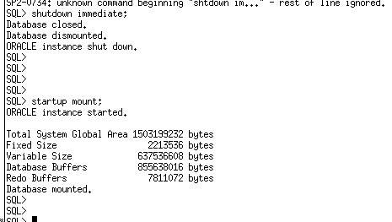
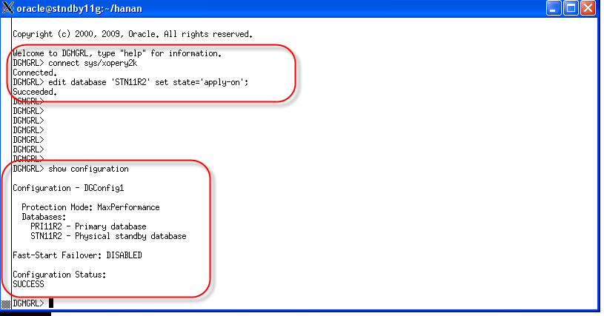
Shut down the physical standby database and restart it in MOUNT mode
Standby
Standby
Invoke DGMGRL and restart the MRP process
Notes:
25

Slide 26
Appendix

Slide 27
Tackle Load Testing Challenges
Development, Results Analysis, Reusability
Long development cycles
Simulated data
Difficult to interpret results
Lots of expertise required
High cost and resource intensive
Dedicated / Shared Labs
Only when application Change
Automate test development
Use production data
Secure in-cloud load testing
Integrated deep-dive analysis
Easy interpretation of results
Back-end testing
Use less resources
Use real production hardware
CPU Patch has to be tested
Notes:
Testing, such as Performance testing, Business Infrastructure Scalability Load Testing, High Availability load testing and stress tests takes time. Time to create scripts, scenarios and then more importantly to identify problems and especially to identify unobvious potential problems. There is also an added cost because traditional testing is done via the front end, so any UI changes also mean changes to the scripts written. In addition, testing in the past has been simulated using artificial business flows that don’t truly represent real production activities. It is also a joint effort between many parties, business analysts, infrastructure and operations to name a few. All this said we provide a new way to perform load testing easier and more confidently. Oracle confirms this direction with their development of Real Application Testing. Only we can do what they do across platforms, across tiers, and across clusters, also including parameterization.

