Slide 1
DBA InfoPower
Taking the Risk out of IT Operations™
Oracle Real Application Testing
NOCOUG Fall Conference
Hanan Hit
Director of Customer Support
Hanan.Hit@dbainfopower.com
Nov 13 2008
Notes:
1

Slide 2
Agenda
Testing Intro
The need for database testing
Database Replay
Workload Capture
Workload Pre Processing
Replay Workload
Analysis & Reporting
SQL Performance Analyzer
Q&A

Slide 3
Why Test?
Do you really want to go live like this?

Slide 4
Test What?
Internally developed applications
Packaged Applications
even if you don’t posses the source code
Remote Services
even if you don’t know anything about how the services were written

Slide 5
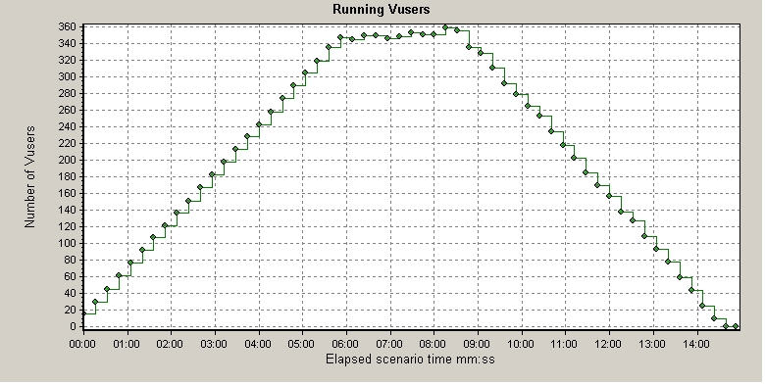
Business/Scalability Graphs
Value
Old
Value
New

Slide 6
The Need For Database Testing
Choose the right architecture – system changes are fact of life
Hardware
Software
Deploy with confidence
Get the system right at the first time, once and done
Validate functionality/performance under real-world conditions
Competitive Position
Remove dependence of test cases on UI design
Cut Test-Debug-Fix cycle time
Apply a patch etc.
Reduce testing and validation expense (both time and money )
Low success rate
Causes of low success rate – Inability to test with real world production workloads

Slide 7
What is Real Application Testing?
New database option available with EE only
Includes two new features
Database Replay (DB Replay)
SQL Performance Analyzer (SPA)
SQL Tuning Set (STS) functionality is shared between Real Application Testing option and EM Tuning Pack
Advance functionality requires additional packs
Diagnostic Pack for DB Replay
Tuning Pack for SPA
Price - Very Good Question ($11,500 per processor or $230 per named)

Slide 8
Value Proposition
Value
Reduces testing cost (Cheaper)
Improves testing quality
Business Benefit
Faster technology adoption (Faster)
Lower risk (Better)
Solution for the Agile Business

Slide 9
Database Replay
Recreate actual production database workload in test environment
Identify, analyze and fix potential instabilities before making changes to production
Capture Workload in Production
Capture full production workload with real load & concurrency info
Move the captured workload to test system
Replay Workload in Test
Make the desired changes in test system
Replay workload with production load & concurrency
Honor commit ordering
Analyze & Report
Errors
Data divergence
Performance divergence

Slide 10
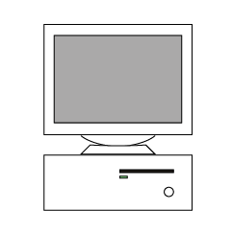
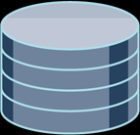
Database Replay: Supported Changes
Client
Client
…
Client
Changes Unsupported
Middle Tier
Changes Supported
Database Upgrades, Patches
Schema, Parameters
RAC nodes, Interconnect
OS Platforms, OS Upgrades
CPU, Memory
Storage
Etc.
Recording of External Client Requests
Storage

Slide 11
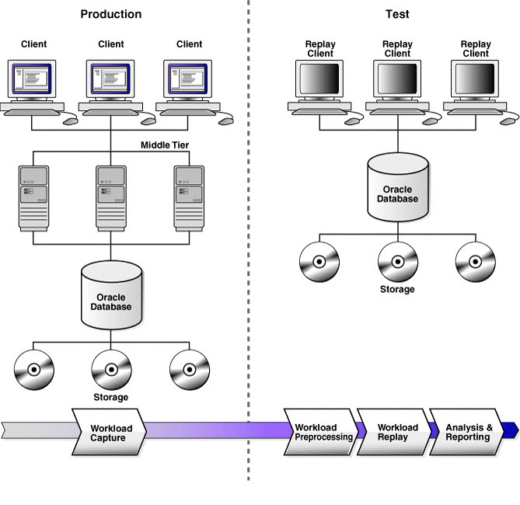
Database Replay Overview

Slide 12
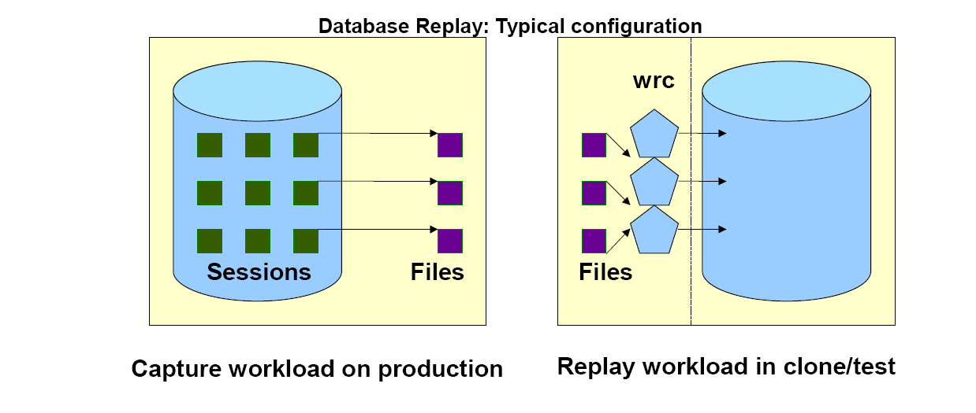
Database Replay: Typical Configuration

Slide 13
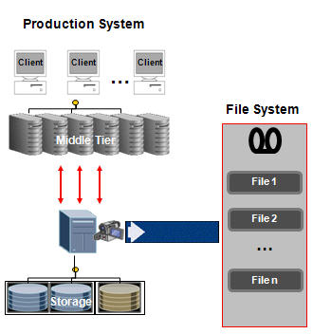
Workload Capture
All external client requests captured in binary files
System background, internal activity excluded
Minimal performance overhead for capture
For RAC, shared and local file system supported
Specify interesting time period for capture, e.g., peak workload, month-end processing, etc.
Notes:
Overhead
Performance Overhead for TPCC is 4.5%
Memory Overhead : 64k/session

Slide 14
Workload Capture Steps
Create a directory in order to save the captured files:
mkdir–p /home/oracle/api_dir
create directory API_DIR as ‘/home/oracle/api_dir’
Add Limits to the capture load
In SQL*Plus (As system)
begin
dbms_workload_capture.ADD_FILTER(fname=> 'NO_SYS' , FATTRIBUTE=> 'USER', FVALUE=> 'SYS');
dbms_workload_capture.ADD_FILTER(fname=> 'NO_SYSTEM' , FATTRIBUTE=> 'USER' , FVALUE=> 'SYSTEM');
dbms_workload_capture.ADD_FILTER(fname=> 'NO_SYSMAN' , FATTRIBUTE=> 'USER' , FVALUE=> 'SYSMAN‘
dbms_workload_capture.ADD_FILTER(fname=> 'NO_SCOTT' , FATTRIBUTE=> 'USER' , FVALUE=> ‘SCOTT');
end;
Shutdown and startup restrict the Prod DB (Not mandatory)

Slide 15
Workload Capture Steps Cont.
Start the Capture
begin
dbms_workload_capture.start_capture(name=> 'CAPTURE-TSTDB01-20080306101900' , dir=>'API_DIR', AUTO_UNRESTRICT=> TRUE , DURATION=> NULL);
end;
Run load on the system
Finish the Capture
begin
dbms_workload_capture.finish_capture();
end;
Identify the ID of the capture
select id , name , directory, start_time , end_time , status , duration_secs, dir_path from dba_workload_captures where rownum < 2 order by id desc ;

Slide 16
Workload Capture Steps Cont.
Export the AWR Report – Make sure not to Flashback
begin
DBMS_WORKLOAD_CAPTURE.EXPORT_AWR(capture_id => <cap ID from previous step>);
end;
Copy the Captures files to the test machine
scp * oracle@192.168.1.61:/home/oracle/api_dir

Slide 17
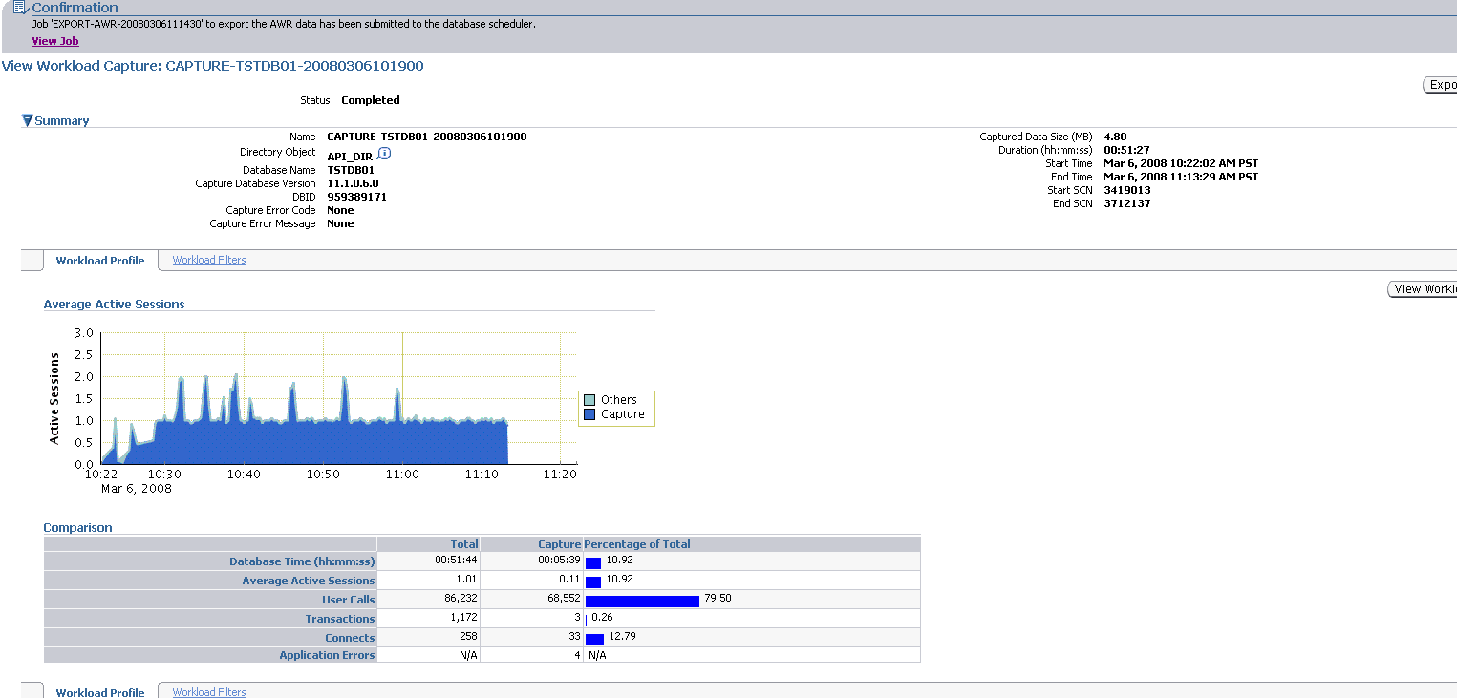
Workload Capture Steps Cont.

Slide 18
Capture Options
Workload can be filtered to customize what is captured
Filter Types
Inclusion Filters: specifies which sessions should be captured
Exclusion Filters: specifies which sessions should NOT be captured
Filter Attributes
Workload capture can be filtered using any of the following session attributes
User
Program
Module
Service
Session ID
Workload capture can be run on-demand or scheduled to run at later time

Slide 19
Workload Pre-Processing
Set up test system
Logically similar data as production
Use RMAN to physically restore production DB from backup
Use Snapshot standby
Use imp/exp, Data Pump, etc.
Keep in mind
Processing transforms captured data into replay files and generates necessary metadata
Must be done on same version of database as replay system
Recommended practice: process on test system
Once processed, workload can be replayed many times
For RAC, if using local file system, copy all capture files to single location for replay

Slide 20
Workload Pre-Processing Steps
Process capture data on test database – Needs to be executed only once
begin
dbms_workload_replay.process_capture(capture_dir=>'API_DIR');
end;

Slide 21
Replay Workload
Replay Client is a special client program that consumes processed workload and sends requests to the replay system
Special multi-threaded OCI client that replays the capture files
Replay requests preserve timing, concurrency and dependencies seen on the capture system
Replay Client consists of one or more clients. For workloads with high concurrency, it may be necessary to start multiple clients to drive workload.
Once all replay clients are started, workload replay is then initiated by user
Replay Driver
Replay Client
Replay Client
File 1
File 2
…
File n
Metadata
Replay Files

Slide 22
Replay Options
Synchronized Replay
Workload is replayed in full synchronized mode
Identical concurrency and timing as production workload
Transaction commit order is honored
Ensures minimal data divergence
Unsynchronized Replay
Workload can be replayed in unsynchronized mode
Useful for load/stress testing
High data divergence
Three (3) parameters provided to control degree of synchronization
Think time synchronization
Commit order synchronization
Connect (logon) time synchronization

Slide 23
Replay Options
Unsynchronized Replay Parameters
Think time synchronization
Controls think time between database calls
Auto (Default): Adjusts think time so as to maintain captured request rate
Percentage
0% No think time, highest possible request rate
<100% Higher request rate
100% Exact think time
>100% Lower request rate
Commit order synchronization
Controls commit order between transactions
In asynchronous mode, commit order not honored – transactions are committed as soon as commit call is issued
Connect (logon) time synchronization
Controls when sessions are created
0%: All sessioSn are connected immediately
100% (Default): Sessions connect at same time as in captured system

Slide 24
Replay Options
Number of Replay Clients
Configurable by user
Client Calibration Advisor recommends number of replay clients needed for specific workload
Replay clients are multithreaded clients that can drive multiple workload sessions each

Slide 25
Replay Workload Steps
Initialize capture data on test database
begin
dbms_workload_replay.initialize_replay(replay_name=> LONGTEST ' , replay_dir=>'API_DIR');
end;
Prepare capture data on test database
begin
dbms_workload_replay.prepare_replay;
end;
On the workload generation host(s), start the Workload Replay Clients.
wrc system/<password>@TSTDB02 replaydir=/home/oracle/api_dir
Start the reply process
begin
dbms_workload_replay.start_replay;
end;

Slide 26
Replay Workload Steps Cont.
Check Replay progress...
Workload Replay Client: Release 11.1.0.6.0 - Production on Thu Mar 6 11:05:29 2008
Copyright (c) 1982, 2007, Oracle. All rights reserved.
Wait for the replay to start (11:05:29)
Replay started (11:06:10)
Replay finished (11:59:00)

Slide 27
Replay Workload Progress

Slide 28
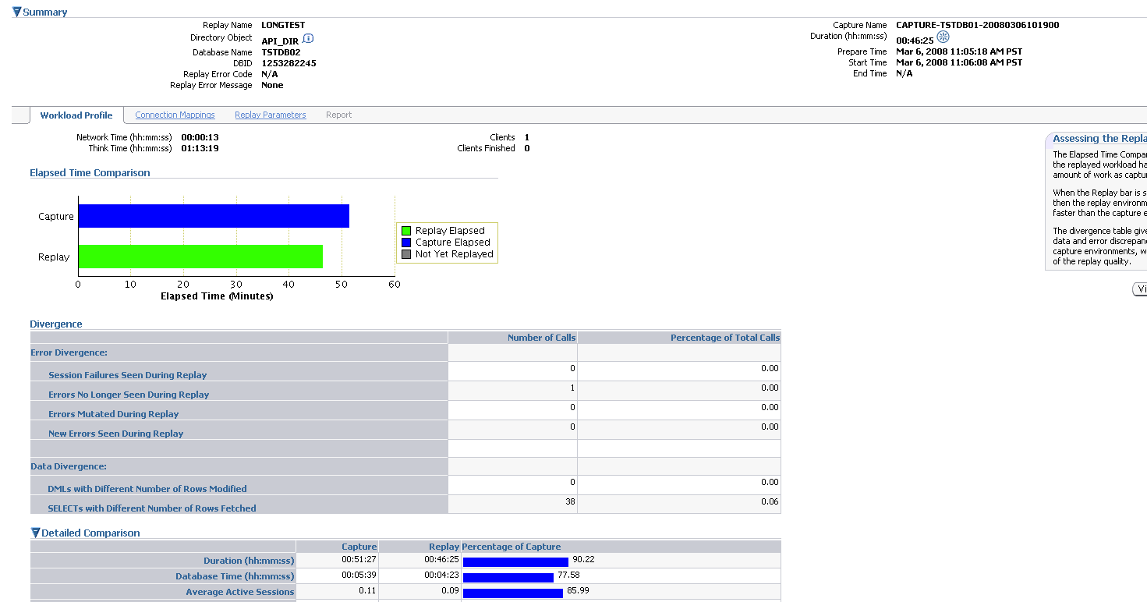
Replay Workload Summary

Slide 29
Analysis & Reporting
Comprehensive reports are provided for analysis purposes
Three (3) types of divergences are reported
Data Divergence
Number of rows returned by each call are compared and divergences reported
Error Divergence
For each call error divergence is reported
New: Error encountered during replay not seen during capture
Not Found: Error encountered during capture not seen during replay
Mutated: Different error produced in replay than during capture
Performance Divergence
Capture and Replay Report: Provides high-level performance information
ADDM Report: Provides in-depth performance analysis
AWR, ASH Report: Facilitates comparative or skew analysis

Slide 30
Analysis & Reporting Steps
Generate the AWR Report for the duration of the reply
Generate the AWR comparison between two instances Must export the AWR from the source database
Generate the ASH report from the test machine.

Slide 31
Workload Types Supported
Supported
All SQL (DML, DDL, PLSQL) with practically all types of binds
Full LOB functionality (Cursor based and direct OCI)
Local transactions
Login/Logoffs
Session switching
Limited PL/SQL RPCs
Limitations
Direct path load, import/export
OCI based object navigation (Abstract Data Types) and REF binds
Streams, non-PL/SQL based AQ
Distributed transactions, remote describe/commit operations
Flashback
Shared Server

Slide 32
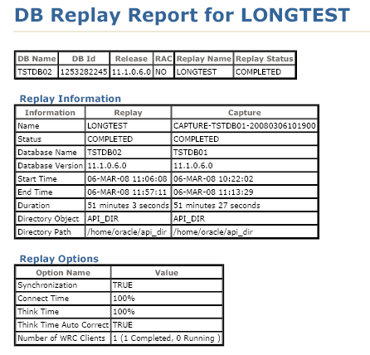
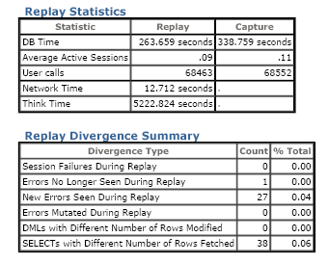
Analysis & Reporting

Slide 33
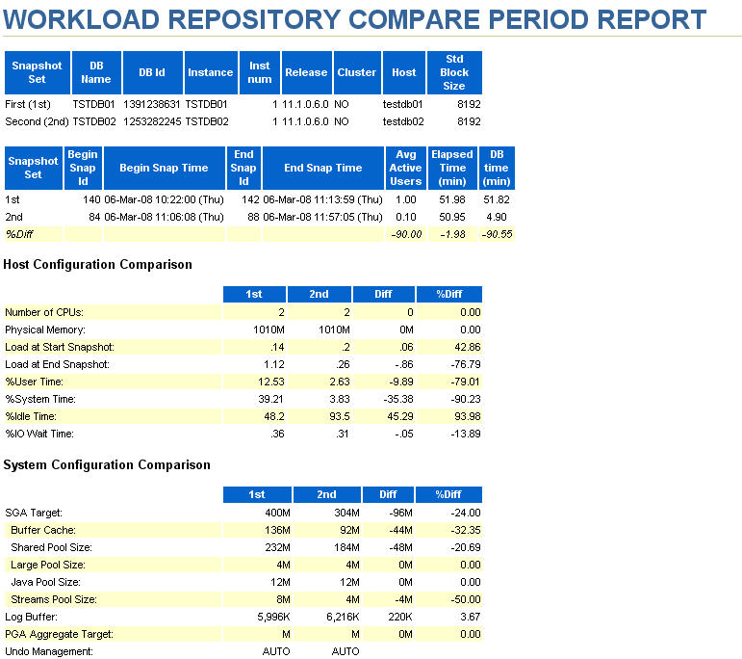
Analysis & Reporting

Slide 34
Analysis & Reporting

Slide 35
Analysis & Reporting

Slide 36
Required Privileges
Any “Non-SYS” user with DBA Role
SYSDBA role is not mandatory
Does not have to be the user whose workload is captured
“Execute” privileges on DBMS_WORLOAD_CAPTURE/REPLAY procedures
DBMS_WORKLOAD_CAPTURE
START_CAPTURE, FINISH_CAPTURE, REPORT(), ADD_FILTER, DELETE_FILTER
DBMS_WORKLOAD_REPLAY
PROCESS_CAPTURE,INITIALIZE_REPLAY, PREPARE_REPLAY(), START_REPLAY(), CANCEL(), REPORT, ADD_FILTER, REMAP_CONNECTION
Capture and Replay user can be different if they have appropriate privileges

Slide 37
SQL Performance Analyzer (SPA)
Test impact of change on SQL query performance
Capture SQL workload in production including statistics & bind variables
Re-execute SQL queries in test environment
Production
Test
Client
Client
…
Client
Re-execute SQL Queries
Middle Tier
Capture SQL
…
…
Use SQL Tuning Advisor to tune regression
Oracle DB
Storage

Slide 38
SPA Benefits
Enables identification of SQL performance regressions before end users can be impacted
SPA can help with any change that impacts SQL execution plan
DB upgrades
Optimizer statistics refresh
New indexes, materialized views, partitions, etc.
Regressed SQL can be fixed with SQL Tuning Advisor and SQL Plan Baselines
Integrated with query optimizer
Captures SQL workload with low overhead

Slide 39
SQL Performance Analyzer Steps
Capture SQL workload
Move SQL workload to test system
Execute SQL before making changes
Execute SQL after making changes
Compare & analyze performance

Slide 40
What’s Good
Allows capture workload to be replayed on a test system to assess the impact of change
Repetitive test scenarios at the database level
Easy way to perform regression testing
No need to use syntactic test values or homegrown scripts
Was back-ported to 9i & 10g
Requires less capital (Human & I&O) - lower operational costs
The DBA role just got extended
No Need for manual data entry

Slide 41
What’s Bad
Multiple replays yields different DBID
looks like system generated
No way to parameterize the data
Most of the issues are “non-database” issues
Doesn’t have any business context – DBA tool
Missing key processes for DSS systems (SQL Loader etc.)
Supported only with EE
Oracle Jobs can be very heavy
Management can easily think that this is a good enough option to replace “legacy” scalability testing methods
Think time between database calls assumes linear regression

Slide 42
Thank You
Q&A
“If the facts don’t fit the theory, change the facts.”
-Albert Einstein

